Slide 1


Aspire to Achieve
Revision Techniques Evening
For Parents
Wednesday 21st October, 2015
6.30-7.30pm.
Ideas and techniques to help you support your child’s revision to achieve their potential

Slide 2
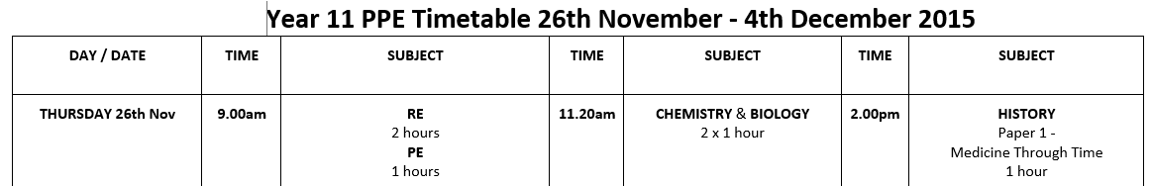




In Your Revision Packs….

Slide 3
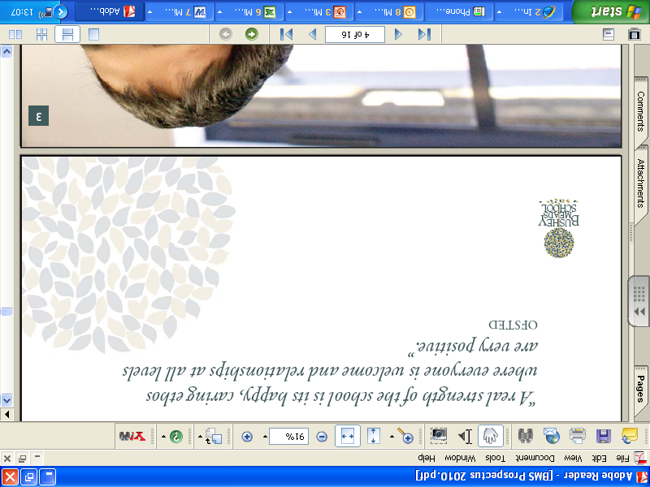
Important Dates
Wednesday 4 November – Year 11 Parents’ Evening
10 November – 6th Form Open Evening
26 November - Pre-Public Examinations begin
11 December - 6th Form Taster Day
PPE Results first week back in January
Summer exams May and June 2015
Results 25th August 2015

Slide 4
What is Revision?
Revision is another word for reviewing or re-visiting.
It allows students to:
reinforce school learning;
quickly identify what they don’t know….and more importantly, what they do know;
make links with other learning and check understanding;
practise applying all that knowledge and those skills under timed conditions-ready for the way it will be tested in an exam.

Slide 5

You make the difference!
‘The Campaign for Learning’ found that parental / adult support is 8 times more important in determining a child’s academic success than social class.
The Good News!
….is that you don’t need to be an expert in any of the subjects your child chooses to make a real difference. You also don’t need to give up your life and other responsibilities – you just need to know how best to spend the time you do have.
Your support, encouragement and interest can make a spectacular difference to your child’s motivation and ability to cope with the academic and organisational demands of the exam period.

Slide 6



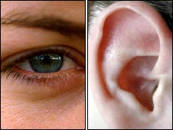

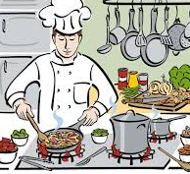

The Learning Pyramid
We learn….
10% of what we read
20 % of what we hear
30 % of what we see
50 % of what we see and hear
70 % of what we discuss
80 % of what we experience
95 % of what we teach others

Slide 7



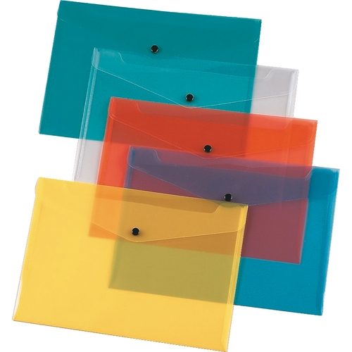

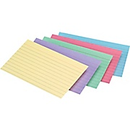



So...the practical advice
highlighters
computer access
past papers
revision guides
text-books
index cards
paper
bag/box
coloured pens
post-its
lamp
calculator
pin-board
diary
notebooks
watch
alarm clock
A Revision toolkit:

Slide 8

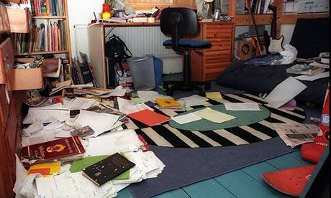
The Challenges
Short term pain-long term gain?
Students will differ in their ability to take responsibility for their learning, organisational skills and levels of motivation.
Notes:
One of the hardest demands on students is that of understanding the long-term importance of doing the best they can, and learning to shelve short-term fun at times in the interest of long-term benefits (not easy even for adults)
Students will also differ in their levels of maturity,

Slide 9
Does your child have a quiet, dedicated space to work in?
Revision starts early.
‘Snack, don’t binge!’- Studies show that ‘cramming’ or bingeing on learning isn’t as successful as snacking. Students do significantly better if they regularly review their learning.
20-30 mins spells work best.

Slide 10
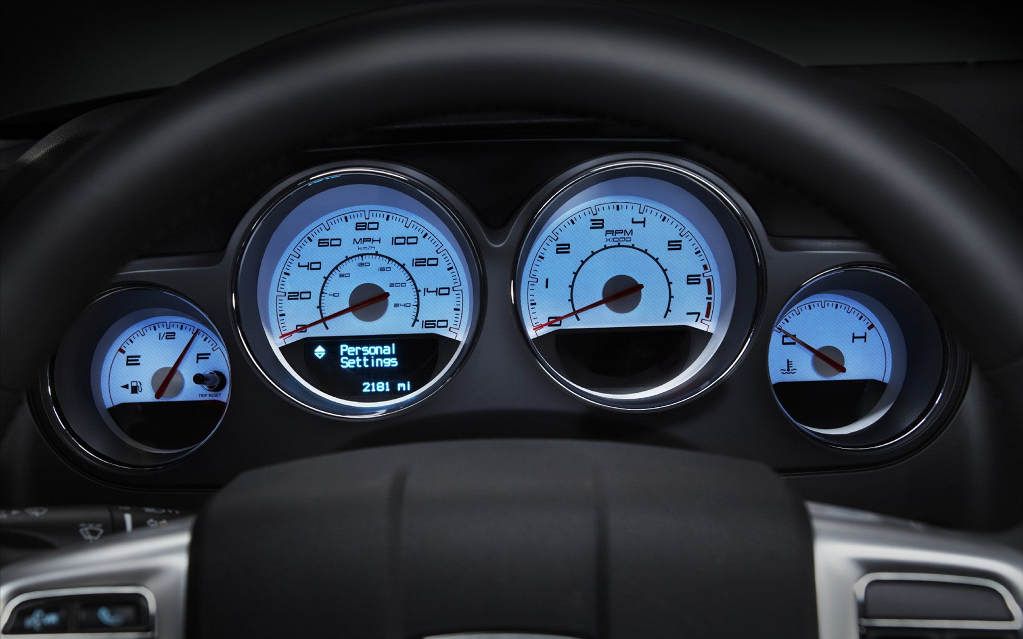
Fix your dashboard
Growth Mindset
Goal setting is an important motivator. Everyday, millions of people drive into work.
Their dashboard is the first thing they see on their way into work, and the last thing they see on the drive home.
You can help your child fix their mental-dashboard.
What is their goal? Why are they revising? Who inspires them?

Slide 11


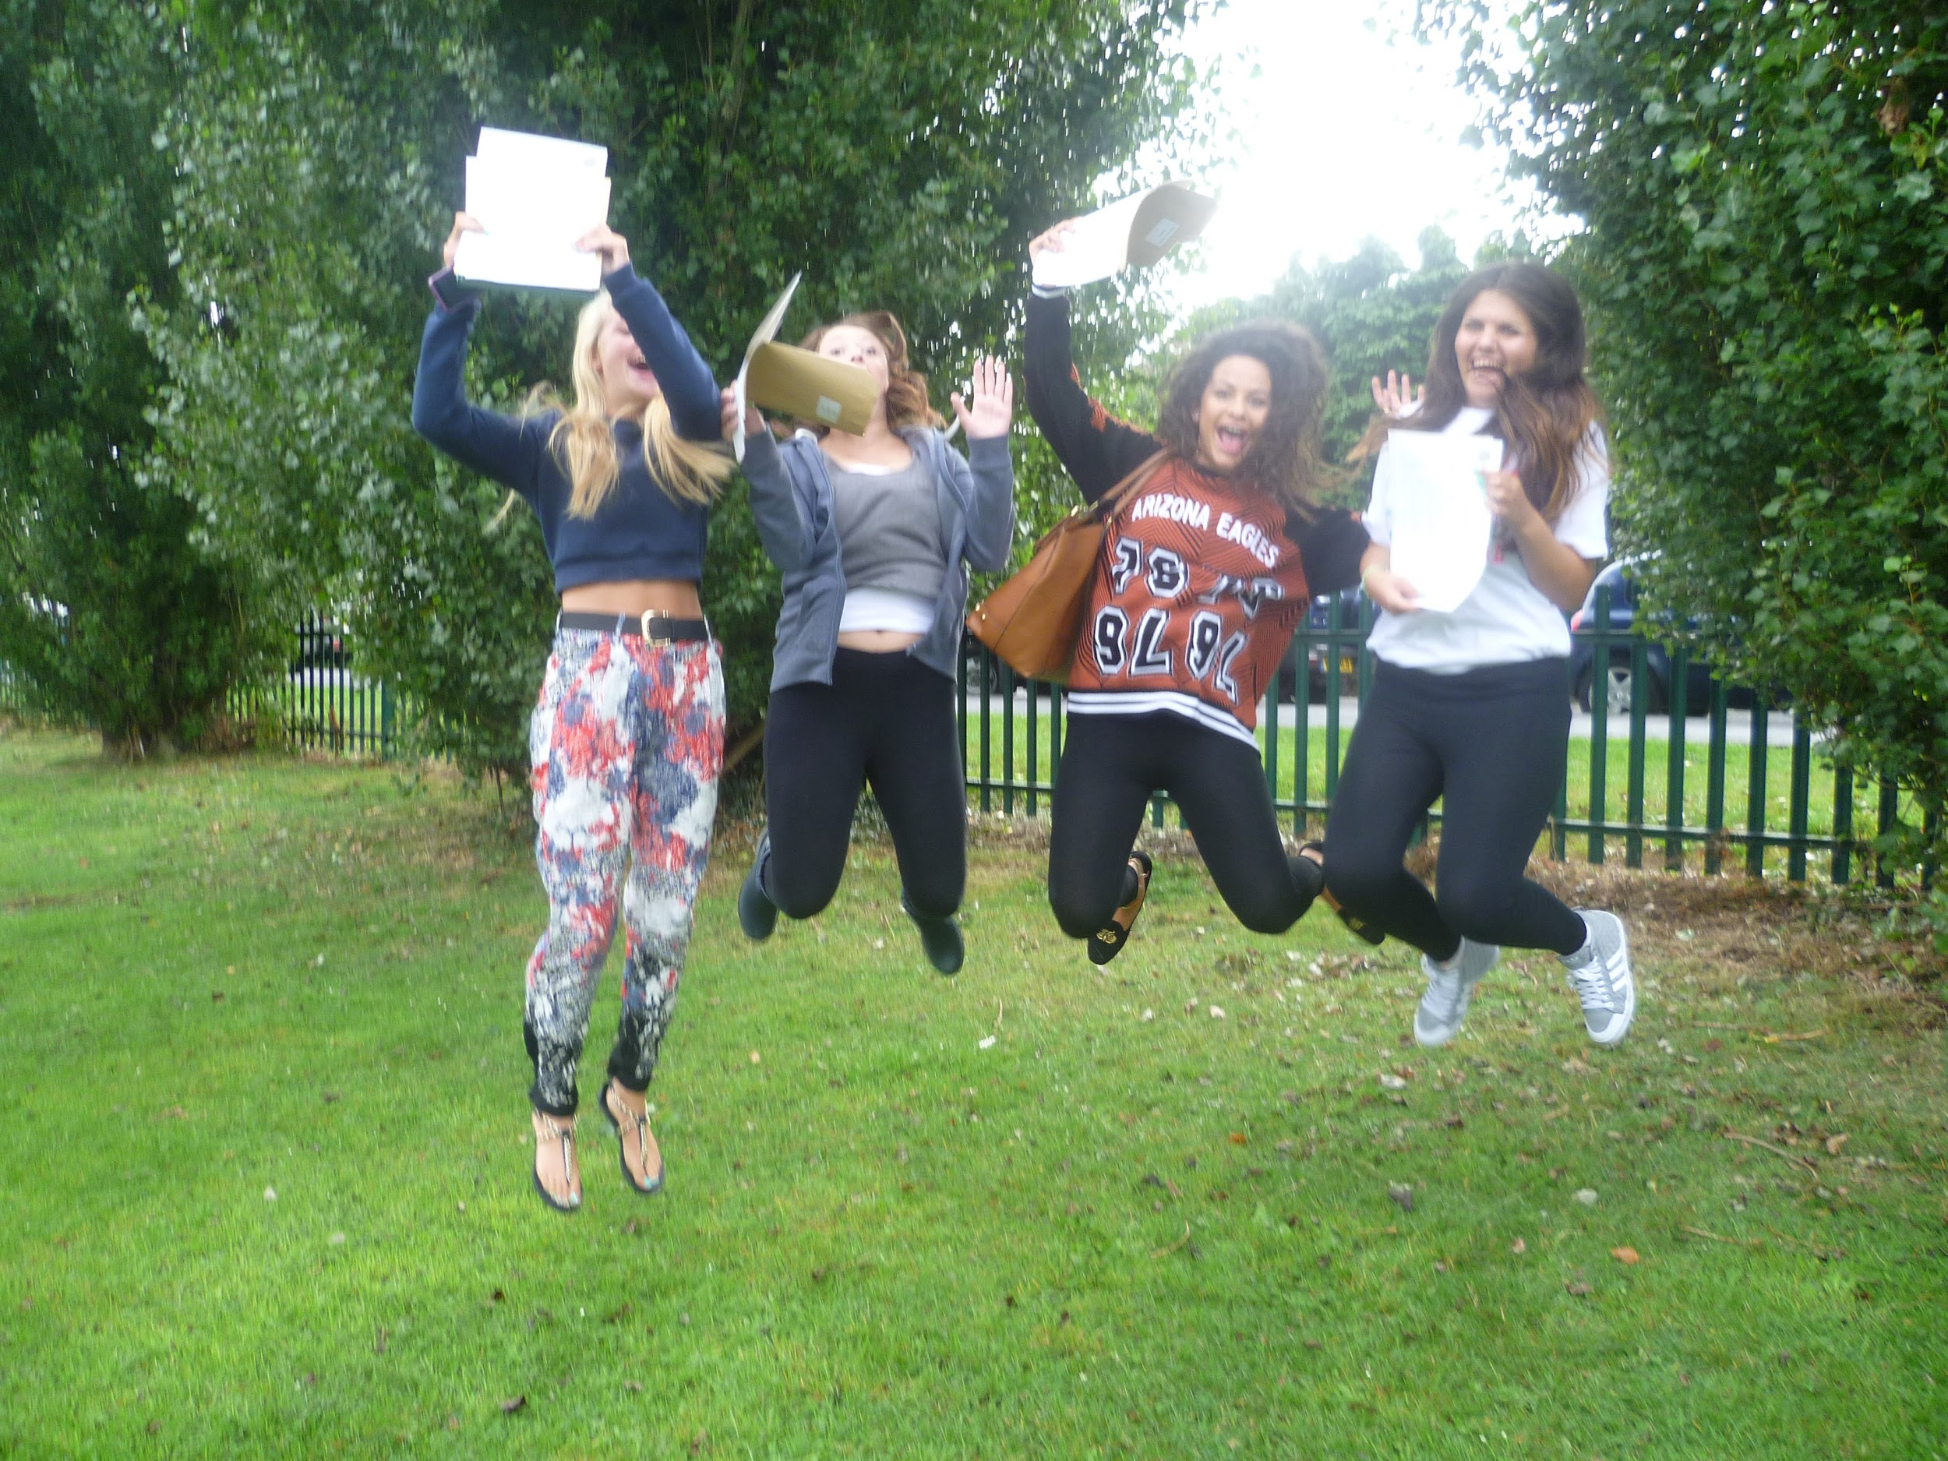





Slide 12
But what kind of revision is it?
Which student does better in an exam?
Student 1 conscientiously does fifteen hours revision reading through class notes.
Student 2 only does ten hours revision: two hours making mind-maps; two hours creating flashcards of key terms; three hours writing timed essays; two hours collecting together all the past papers and looking for patterns in the questions asked; half an hour doing the hardest question they could find, followed by half an hour with their teacher talking it through…. Then they spend five hours hanging out with their friends and watching TV.

Slide 13
But what kind of revision is it?
Skills Development
Using a revision wall to display learning
Writing exam answers under timed conditions
reading model answers
using past papers/planning answers
Content learning:
reading notes
using text books
mind-maps / diagrams
Highlighting/colour coding
flash cards
Getting Feedback from Experts
Working with study groups/other students
Comparing model answers against your own work
Creating your own exam questions
Handing in exam work for feedback
one-to-one discussions with teachers

Slide 14
Working out the best time for revising...and sticking to it!
Short bursts…
--When does your child seem to work best?
--What variables exist that you should take into
account when preparing a revision timetable?
--What’s the prize at the end? 5 min snack
break- an episode of Eastenders?
Notes:
If you know they have football training every thursday between 5.30 and 7.00pm, block that off on the revision timetable. Don’t allow your child to set themselves up for failure.

Slide 15
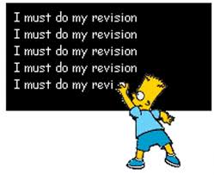
A variety of revision techniques
To help you revise in a way that is best for you.
To practise revising ‘more smartly’not harder.
To learn ‘brain -friendly’ revision techniques.
Please remember,different techniques work better for different people!

Slide 16
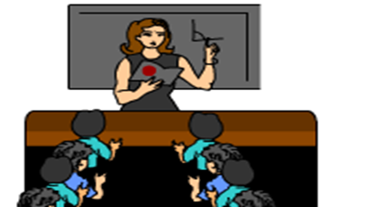
Learning by rote
Learning by rote is simply reading the text over and over until you remember it. It is the most basic kind of revision, but without the help of other techniques may not be very effective and it can be very boring. There are a few students with excellent auditory memories, who can learn effectively this way.

Slide 17
By Rote
Read it again and again and again and again and again and again and again and again and again and again and again and again and again and again and again and again and again and again and again and again and again and again and again and again and again and again and again and again and again and again and again and again and again and again and again and again and again and again and again and

Slide 18
Brain friendly revision
You remember the words at the beginning and at the end, it’s the ones in the middle that get lost– why?
It helps to make categories of words in your mind – colours, modes of transport, moods etc.
It helps to make links or associations – fish, chips, peas, salt and vinegar
It helps if words are repeated – e.g. ‘the’
Some words stand out
Some words have strong emotion attached to them, e.g. ‘exams’
Notes:
Explain how it helps if you know there are for example categories

Slide 19

Note making
Your own notes are best.
Whilst revision guides can be useful, the more you personalise your revision the more effective it will be.
The notes you make are best. The process of making the notes is part of your revision and once you “own” the work it is easier to remember.

Slide 20
Chunking
Chunking is breaking up a big piece of information into smaller chunks rather like steps in a ladder.
It can be used for numbers and words.
Often students use bullet points to break up information.
Try to remember this by breaking it up into chunks
The average person can take in four numbers or words at a time, can concentrate on revision for a maximum of 45 minutes at a time and remembers information best shortly before bedtime
Chunked:
Remember 4 words/numbers at a time
Revision max 45 mins.
Remember best before bedtime

Slide 21


Mnemonics help you to remember by using short words that stand for something to help you. Here is a Mnemonic for REVISION.
Rest
Exercise
Variety
Imagination
Structure
Individual
Ongoing
Not too long

Slide 22

Association
Association helps a lot of people to remember, because it is much more powerful when we use our imagination. The idea is to link objects and ideas to each other in the craziest way possible.
Mind maps (Also called Spider grams) are good for remembering topics and sub-topics, such as characters in a book.
Concept maps are good for remembering items where the order is important, such as the storyline (plot).

Slide 23
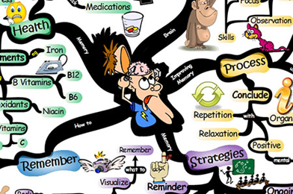
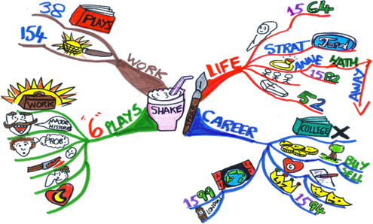
Mind-Maps
1.Imagine a Mind map is like a giant Spider’s Web with all the ideas around it. The spider (or main idea) is in the middle and everything is around it. The most important ideas are in the middle and the sub-topics go out further and further.

Slide 24

Reading out loud
Read revision notes out loud to a particular rhythm
Music playing in the background
Tapping feet
Walking calmly and steadily. This is a sort of walk and talk

Slide 25

Post-its
Write information on post-it notes and place them on the wall, door, large sheets of paper etc.
• Group various things together
• Organise them into what you
know and don’t know – rearrange
as you learn more
• Follow trends or themes

Slide 26

Highlighters
Use different coloured highlighters to pick out key words /themes/ideas/ points etc. Try a different
colour for each theme or topic.
Or
You can use very small post-its to highlight things as you go along.

Slide 27

Make lists
§ Bullet point them
Or
1.number them
Or
a)letter them
According to what suits you best.

Slide 28

Card cover
Two ways to practice with cards:
1. Put the answers on the back, but you will need to remember more at once before you check
OR
2. Use a piece of paper and move down to reveal answers as you guess the contents.
These techniques are very useful for checking that you know key facts.

Slide 29

ENGLISH
ENGLISH LANGUAGE e.g.
Non-fiction texts: GAP - Genre + Audience + Purpose
Descriptive writing: SMILES -
ENGLISH LITERATURE e.g.
S = SUBJECT - What is the poem about?
S = STRUCTURE - How is the poem set out?
S = STYLE - What techniques / poetic devices are used?
Senses
Movement
Imagery
Sentence variety
Emotive
Language
The 3 Ss

Slide 30
‘Spellbound’
Why is the poem called ‘Spellbound’?
Why does the poet use repetition?
What do you think is stopping the speaker from leaving?
The night is darkening round me,
The wild winds coldly blow;
But a tyrant spell has bound me
And I cannot, cannot go.
The giant trees are bending
Their bare boughs weighed with snow.
And the storm is fast descending,
And yet I cannot go.
Clouds beyond clouds above me,
Wastes beyond wastes below;
But nothing drear can move me;
I will not, cannot go.
Additional Sources for help:
BBC Bitesize
S-Cool
Englishbiz
Universal Teacher - Andrew Moore
The British Library
The Student Room

Slide 31

Year 11 Revision
Two definite gems!
Mathematics
Mr Varsani

Slide 32

Mathswatch VLE

Slide 33
MathsWatch VLE

Slide 34


Slide 35


Slide 36
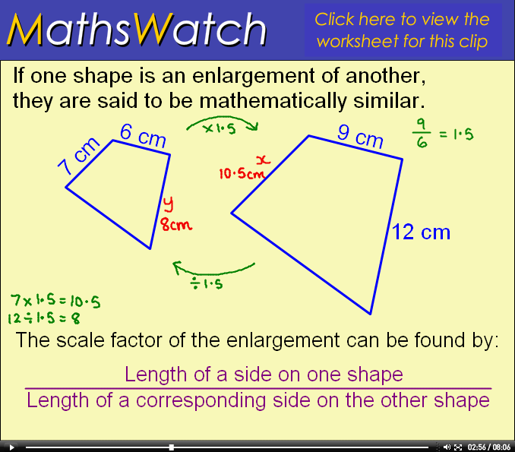
MathsWatch VLE

Slide 37
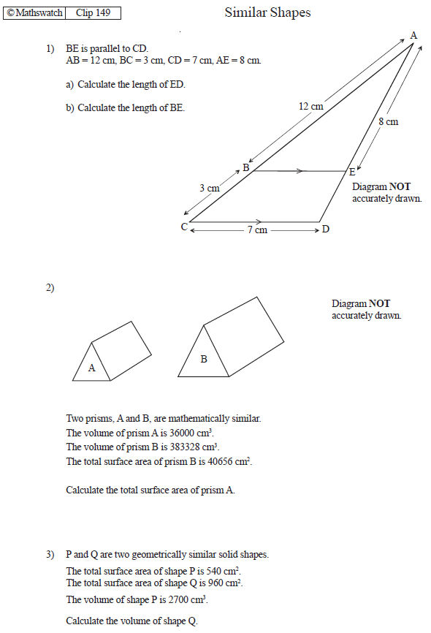

Slide 38
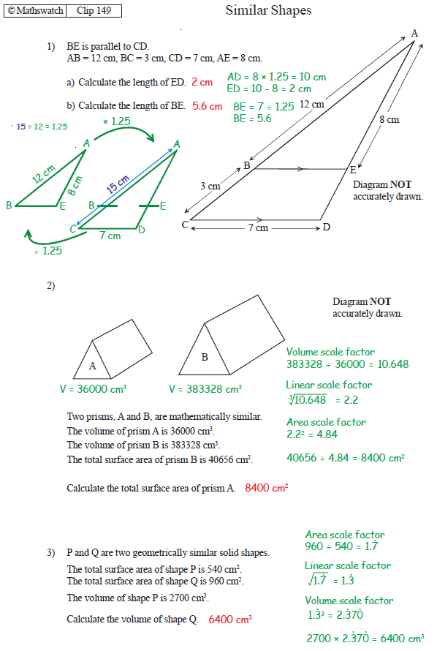

Slide 39
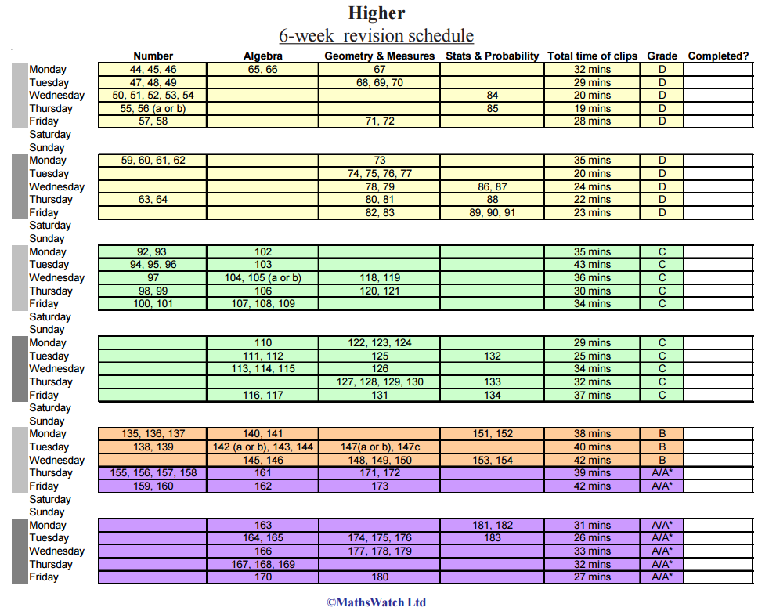
MathsWatch VLE - Tracking progress

Slide 40
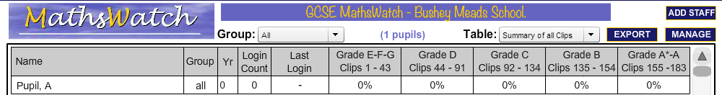
MathsWatch VLE - Tracking progress

Slide 41

Mathswatch VLE - Key messages
Full coverage of the skills required at GCSE level
Also available on mobiles, tablets, ipads
THE STUDENT HAS FULL CONTROL - they have access to everything and can complete anything whenever is good for them (even to and from school!). PLEASE ENCOURAGE USE.
Independent learning and improvement through the use of the video clips
Great worksheets with access to solutions for extra practice
A great visual tracking system to show their progress

Slide 42
PiXL Maths App

Slide 43
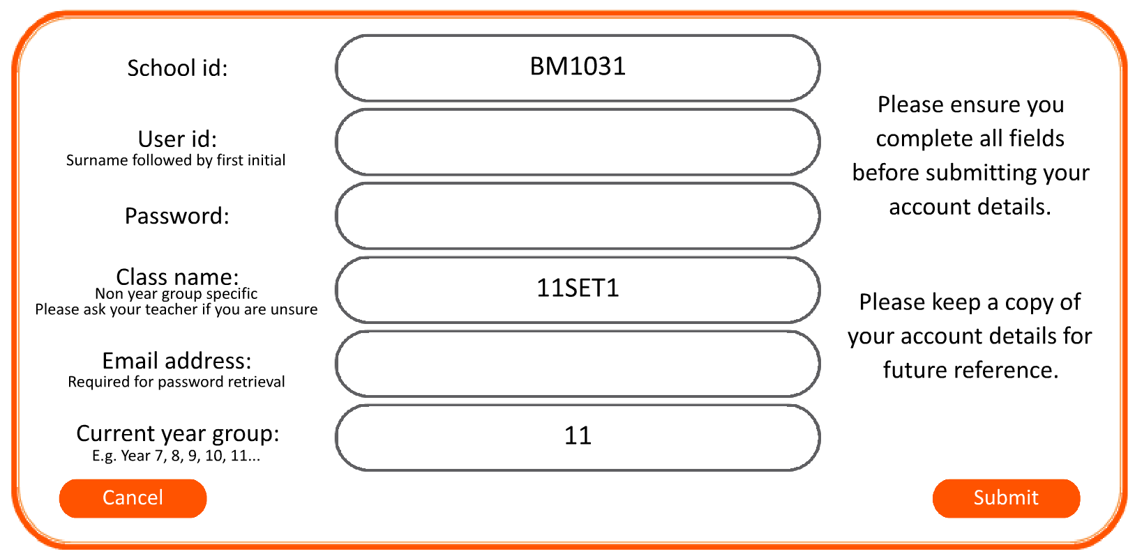
PiXL Maths App
Download or open the ‘PixL Maths’ app
On the top left click on ‘Create a new account’
School id: BM1031
User ID: Your name
Password: (create one)
Class name: PARENTS
Email address: (your email)
Current year group: 11
Log in to the PiXL Maths app
Click on ‘Design a test’, ‘Number’, ‘Fractions, Decimals and percentages’, Begin Test’ and then go for it!!!
Click ‘Mark all’

Slide 44
Well done!!
Now you have the app, you can play with it and ask your child to aswell!
PiXL Maths App

Slide 45
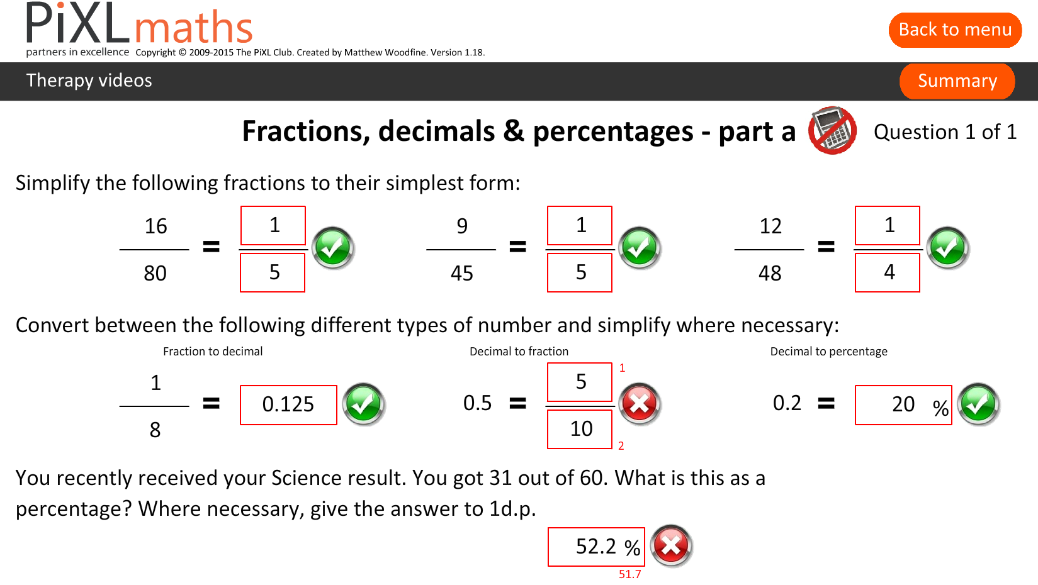
PiXL Maths App

Slide 46
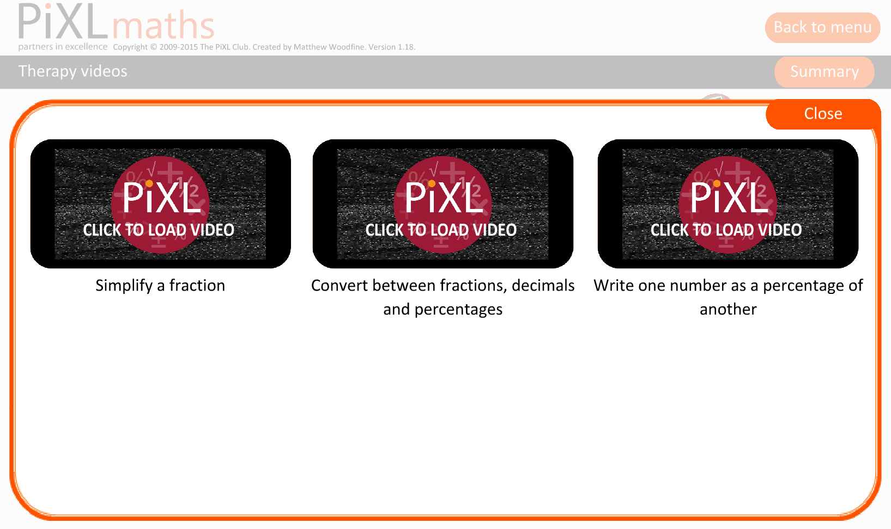
PiXL Maths App - Therapy videos

Slide 47
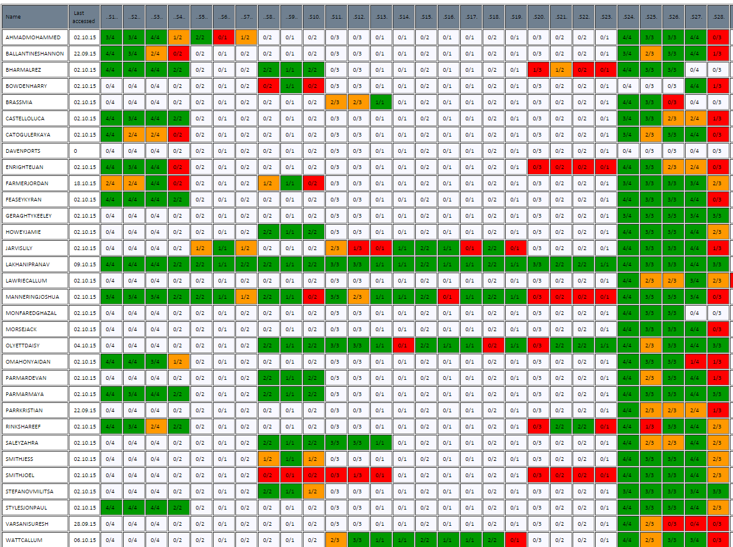
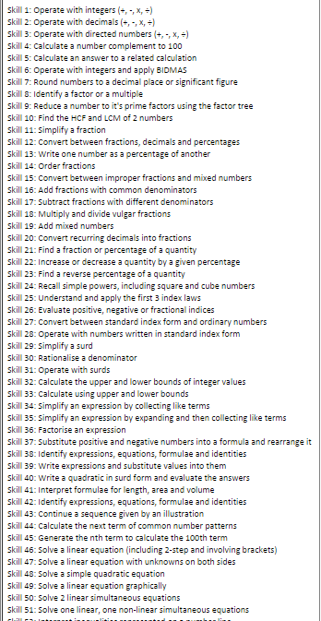
PiXL Maths App - Tracking progress

Slide 48
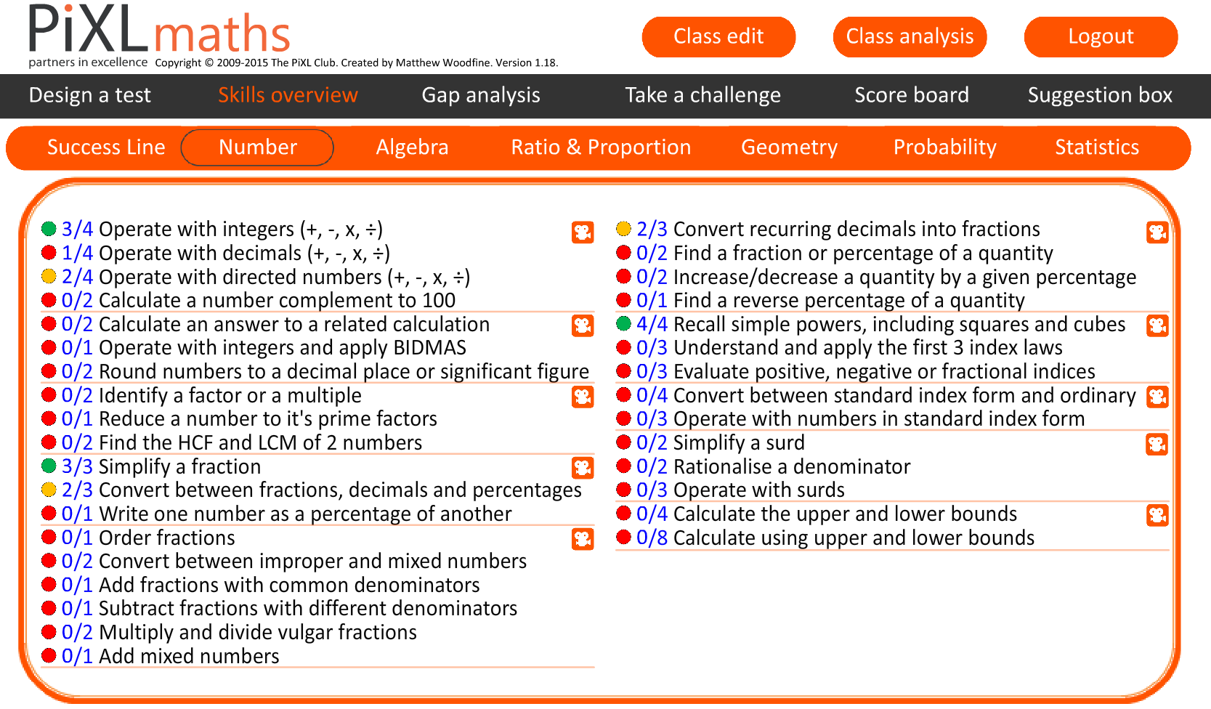
PiXL Maths App

Slide 49
PiXL Maths App - Key messages
Full coverage of the skills required at GCSE level
THE STUDENTS HAVE FULL CONTROL - they have access to everything and can complete anything whenever is good for them (even to and from school!)
Independent learning and improvement through the use of the Therapy Videos
A great visual tracking system to show you and them how well they are progressing.

Slide 50

Please encourage your child to use these resources on a daily basis
Please feel free to contact your child’s Maths teacher if you need anything.

Slide 51
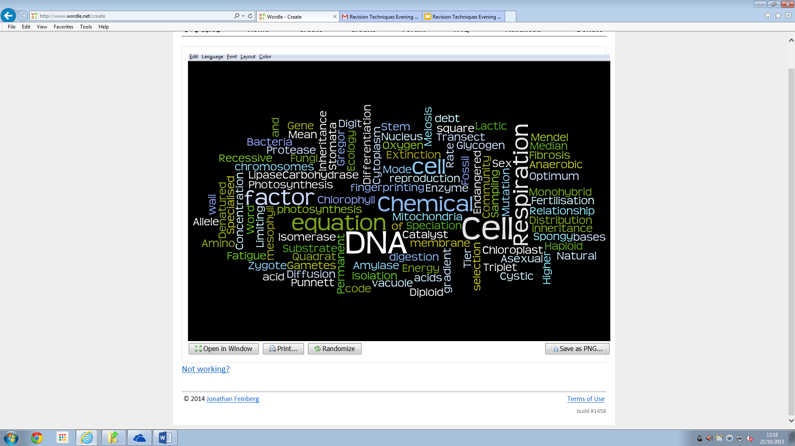
Learning Science is like learning a new language, and for some, just as difficult.
In order to achieve well, students must be confident in using key terminology in the right context and using the correct spelling!

Slide 52
Strategies to learn keywords
Making flashcards
Keyword bingo
Mind maps
Poems
Tarsias- can be made in school by students
The key is to try to make meaningful links between the terms and use them frequently both verbally and in written work.

Slide 53
Keyword match up - Tarsia
Empty the envelope onto the desk and turn the cards upwards
Try to match up the keywords with the definitions to create a shape
Hint: Blank edges point outwards
GOOD LUCK!
Time limit: 5 minutes

Slide 54
Time is Ticking to the Start of Exams...
16,675,200 seconds
277,920 minutes
4632 hours
193 days
27 weeks and 4 days
arnoldl@busheymeads.org.uk

Slide 55
Aspire to Achieve
Thank you for attending this evening

