Slide 1
Bushey Meads Sixth Form
Next Steps Evening
19th June 2019
‘Our School has a Mind to be Kind’
Aspire to Achieve

Slide 2
Higher Education Evening
Sara Ash – Deputy Headteacher
Matt O’Kelly – Associate Leader
Des Timotheou – Deputy Head of Sixth Form
Diana McIldowie– Head of Work Related Learning
Kate Carter - Apprenticeships - iSales Academy
Leon Harris – University of Hertfordshire
‘Our School has a Mind to be Kind’
Aspire to Achieve

Slide 3

Kate Carter
iSales Academy - Apprenticeships
‘Our School has a Mind to be Kind’
Aspire to Achieve

Slide 4




Advanced & Higher Apprenticeships
June 2019
Notes:
My name is ‘Kate’ and I’m here on behalf of the iSales Academy to talk to you about level 3 and level 4 apprenticeships. We are a training provider and we specialise in sales, tech sales and technical apprenticeships. My background is – ran a government funded apprenticeship scheme successfully helping 15 Unified comms sales and marketing and project manager achieve their level 4 apprenticeship.
Currently I am responsible for finding employers to take on apprentices, recruiting the apprentice and placing them, delivering the training (sales, and technical), observing the apprentice in the workplace and being the support for both the apprentice and the employer. Experience in all steps of the process.
- The range of apprenticeship job roles available
- The different levels
- How you find an apprenticeship and
- What you need to do next
Regardless of qualifications, there are apprenticeships for everyone but not many people realise that apprenticeships are for A* students too.
At any one time, there are around 28,000 apprenticeship vacancies available across England.

Slide 5

What are apprenticeships?
A real job with a real employer
A salary
Qualifications and experience
Contract of employment, holiday, sick
Support from a training provider
1-4 Years
Notes:
Lots of people get confused about apprenticeships. That’s probably because they’ve been around for hundreds of years, but they’ve changed a lot in that time.
It’s important to understand that an apprenticeship is a real job, with a real employer.
There’s a myth that apprenticeships are just like work experience, where you’re given basic tasks or asked to make the tea, but this isn’t the case.
Firstly, you get paid a salary – and it can be a really good salary too! We’ll talk more about money later on.
The employer will invest their time and money in helping you to gain qualifications and valuable new skills and experience.
You will be given real responsibilities and expected to work hard, just like anyone else in the company.
For example, We have seen apprentices *Example – “managing projects for Channel4”.
Because it’s a proper job, you will also have a contract of employment, holiday and sick pay - exactly the same as any other member of staff.
Not only this, but you’ll be working towards qualifications throughout your apprenticeship. You’ll be supported by a training provider, who will help you achieve your qualifications and make sure you complete your apprenticeship.
An apprenticeship typically takes 1 to 4 years to complete, depending on the level and the subject you’re studying.
It’s important to remember that apprenticeships aren’t the ‘easy option’. Holding down a full time job and studying takes a certain skill, and it won’t be right for everyone.

Slide 6
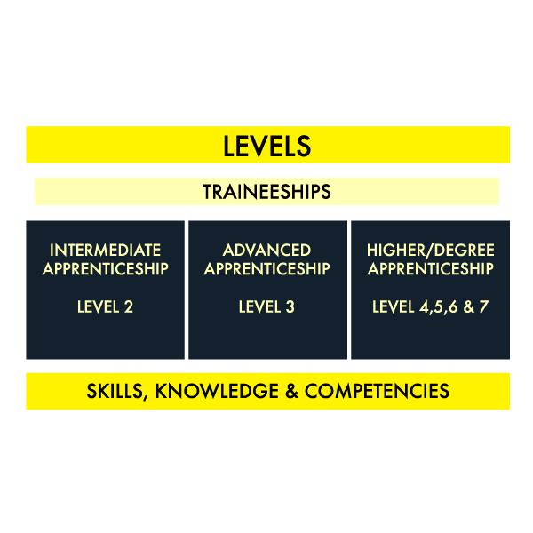
Levels of apprenticeship
Notes:
We now have three levels: Intermediate, Advanced and Higher.
Intermediate is Level 2, which is equivalent to GCSE
Advanced is Level 3, which is equivalent to A level
Higher apprenticeships cover levels 4 through to 7
Level 4 is equivalent to a Higher National Certificate (HNC) or the first year of a degree
Level 5 – 6 is equivalent to a full degree
Level 7 is equivalent to a masters degree
If you want to, you can now start an apprenticeship and work all the way up to achieving a degree. – employers we deal with are keen to carry on the development of the apprentice up to degree level
Which level of apprenticeship you start at will depend on the kind of job that you are applying for. It’s really important not to be held back by only looking for a particular level e.g. degree apprenticeships, because it may be that you need to start at advanced or higher level and work your way up.
Doing a job is completely different to getting a GCSE or A Level and that’s why it can be a bit confusing.
The duration of your apprenticeship will depend on a number of factors including the delivery model that your employer selects and which level of apprenticeship you are studying. As a minimum, all apprenticeships must last for a minimum of 12 months.

Slide 7

Our delivery model – Level 3 Tech Sales
Boot camp
2 days per month – structured sales training
1 day per month – technical qualification
Half a day per month - in situ coaching
Half a day per month – self development
and project work
End point assessment
Notes:
Each training provider will have a different model. 1 day a week at college, time away from role to study – this is ours

Slide 8
Some of the possibilities
Notes:
When we talk about apprenticeships, people often assume we’re referring to traditional apprenticeships like construction and engineering. There are many brilliant apprenticeships in these areas, but there are also hundreds of new apprenticeships in exciting areas that you might not know exist.
This slide gives you an idea of the huge range of apprenticeships available. If you have got a job or career in mind, it’s really worth doing your research as there is a high chance you could get there through an apprenticeship.
Apprenticeships are available in a wide range of industry sectors with employers from large national companies such as the BBC, Barclays Bank, IBM, Airbus, ASOS, ITV and Royal Mail to smaller, local companies.
Employers now see apprentices as a great way of ‘growing their own staff’. Recruitment costs a fortune, experienced employees command a high salary. Employers are now employing apprentices to bring in new ideas and mould them into the company culture.

Slide 9
Are there any jobs?
Over 350,000 apprenticeship starts each year
5 miles = 227 apprenticeships
10 miles = 681 apprenticeships
15 miles = 1821 apprenticeships
20 miles = 2763 apprenticeships
Notes:
I had a look on the Find an apprenticeship website before coming along today.
If you notice, within 5 miles of this school/college today, there are 117 vacancies.
You can see how this number grows the more you increase the distance.
You will need to think about how far you are prepared to travel for work each day.
If you want to think about working locally, then you could be looking for vacancies there.
The one rule is that you will need to be able to get there, on time, every day.
Don’t worry if you don’t know too much about travelling to work. On the new Find an apprenticeship website, there is a journey planner so this will help you when you are applying for vacancies to work out which vacancies are going to be realistic, and which are not in terms of distance.
It is important not to restrict your searches for vacancies to just look at large companies as many small employers offer some excellent vacancies with great packages and career progression opportunities.

Slide 10

Available now level 3!
Digital marketing
Office administration
Accountant
Infrastructure technician
Premier Sport
Nursery assistant
Dental nurse
Software developer
Programmer/designer
IT Support Technician
Retail supervisor
Vehicle technician
Electrical and instrumentation Engineer
Payroll administrator
Book Keeper
Notes:
This is what I located by doing a search on 5th June 2019 – all advanced level 3 apprenticeships within a 15 mile radius
From our perspective we increase our recruitment drive at the beginning of summer to get the best candidates

Slide 11
Available now level 4!
PR & Marketing
Security Analyst
Finance and accounting
Project Manager
Multi Channel Inventory Manager
Head Office (British Airways)
Social and Digital Media
Higher Business
Web Developer
Higher Project Manager
Data Analyst
Notes:
This is what I located by doing a search on 16th March 2018 – all advanced level 3 apprenticeships within a 15 mile radius
There will be lots more available as employers look to start programmes in September
Some institutions start their recruiting process in January for September starts

Slide 12

Look everywhere!
Recruitment websites
Find an apprenticeship – Government website
Not Going to Uni
Recruitment websites such as Indeed
Direct with the Company
BBC
Sky Sports
Channel 4
Glaxo Smith Kline
Warner Brothers
The Armed Forces
Notes:
Who do you want to work for?
How do you get the job?
Unpaid work experience – foot in the door

Slide 13
What if the company I want to work for does not do the apprenticeship I want?
Notes:
Type of company
Unpaid work experience
Daniel Bruce story – work experience

Slide 14

How do I choose?
Think about the sort of company you want to work for
What is their company culture?
What is their industry?
What are their entry requirements?
Where are they based?
What will I benefit from it?
Choose something meaningful and relevant!!
Notes:
This will help you in choosing the right employer for your apprenticeship

Slide 15

Practical and relevant work experience
Opportunity to work with industry experts
Earn while you learn
Avoid student debt
Build Contacts
Why Apprenticeships?
Notes:
The expected salary of a Uni grad is 20k. An apprentice working from the age of 18 during the same 3 year period is expected to be on the same salary if not more with no debt!
My former apprentices are now on salaries ranging from 22k – 30k (Apprentices from 2014 – 2017)
We say – a degree is not a get-rich-quick scheme. A typical starting salary for a graduate is £20,000. Anything more is the icing on the cake

Slide 16
Any questions?

Slide 17
Diana McIldowie
Head of Careers and Work Related Learning
‘Our School has a Mind to be Kind’
Aspire to Achieve

Slide 18
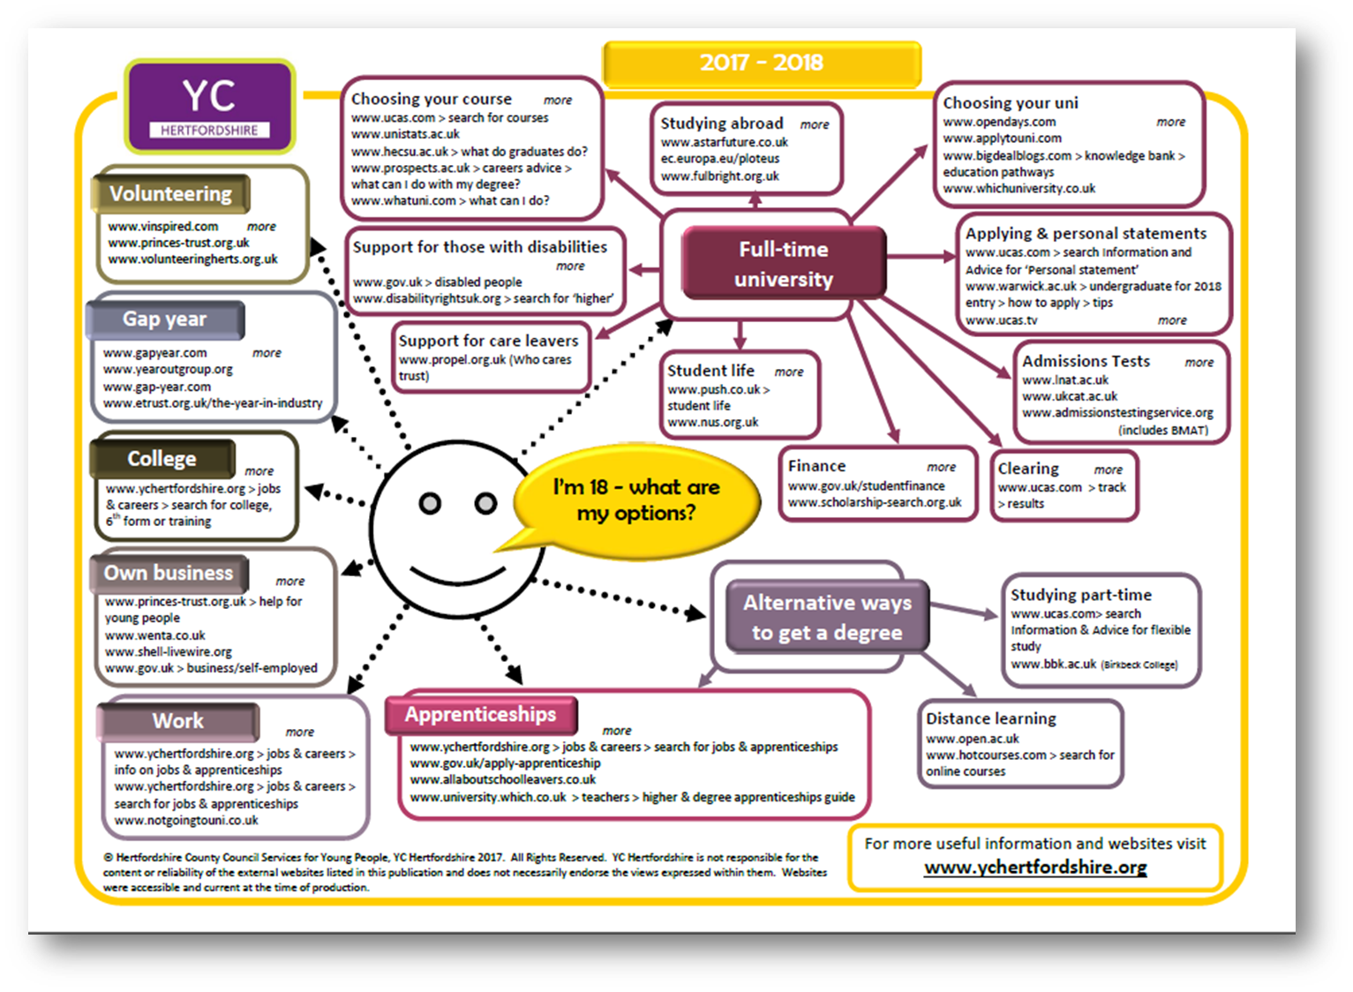

Slide 19
How do we prepare our students for the next step?
Higher Education Convention – March 2020
Year 12 work shadowing – July 2019
Year 12/13 Character Development programme - ongoing
Personal Statement Day – September 2019
Year 13 interviews – November 2019
Advice and guidance from Bushey Meads staff and Youth Connexions – ongoing
‘Our School has a Mind to be Kind’
Aspire to Achieve

Slide 20


Slide 21

3rd and 4th March 2020- Sandown Park Race Course
9th and 10th March 2020- Arena MK - Milton Keynes
‘Our School has a Mind to be Kind’
Aspire to Achieve

Slide 22
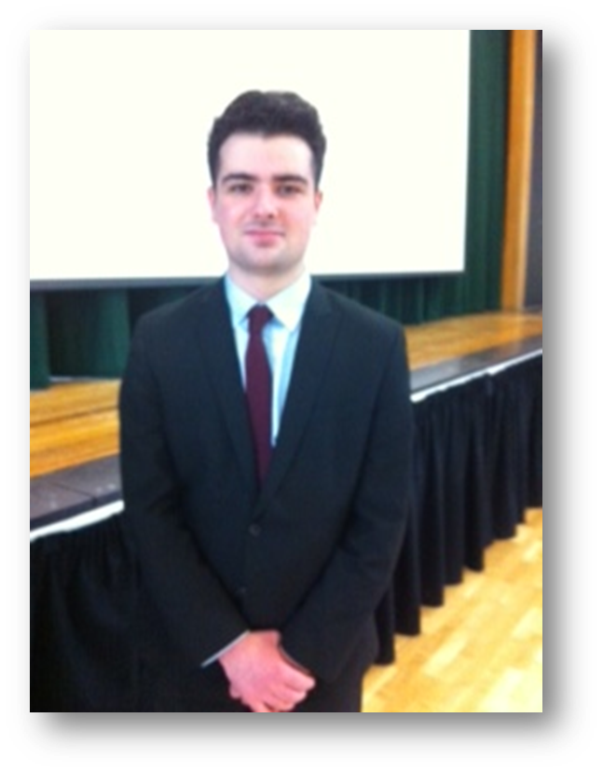
Alex Hirsch – Law Apprenticeship

Slide 23
Foundation Degrees
Typically two years full time study
Stand alone qualification
Additional one year for Honours Degree top up option
West Herts and Oaklands colleges
Validated by University of Hertfordshire
‘Our School has a Mind to be Kind’
Aspire to Achieve

Slide 24
Matt O’Kelly
Associate Leader & Head of Sixth Form
‘Our School has a Mind to be Kind’
Aspire to Achieve

Slide 25

UCAS Apply 2020
On-line application completed in Character Development Groups and at home. Use appropriate email address
Research
Open days
‘Our School has a Mind to be Kind’
Aspire to Achieve

Slide 26
UCAS Applications September 2020
Cost: £25 for two – five choices and £20 for single choice
Total of 5 choices in no order of preference
References written by teachers and CDC’s, with final review by Head of Sixth Form
‘Our School has a Mind to be Kind’
Aspire to Achieve

Slide 27
Personal Statements
Personal statement – suggested structure. Course choice? My A levels. My Community service. Why me?
Personal statement length: 4000 characters or 47 lines
Online support available on Unifrog
‘Our School has a Mind to be Kind’
Aspire to Achieve

Slide 28

Introduction to Unifrog:
Next Steps Evening
‘Our School has a Mind to be Kind’
Aspire to Achieve

Slide 29


What is Unifrog?
Unifrog believe that destinations - where students end up after school - is even more important than their academic performance. They partner with schools to support students to progress into the best opportunity for them.
Unifrog do this by providing a one-stop-shop where students can explore their interests, then find and successfully apply for their best next-step after school.

Slide 30
The Unifrog tools
Exploring pathways
Searching for
opportunities
Recording what you’ve done
Drafting application materials
Making applications
Careers library
UK universities
Activities
Personal Statement
Post 16/18 Intentions
Subjects library
US universities
Competencies
CV / Resumé
Locker
Know-how library
European universities
Interactions
Teacher References
Applications list
MOOC
Oxbridge
Common App Essay
Apprenticeships
College/ Sixth Form
Canadian universities
Asian universities
Special Opportunities

Slide 31
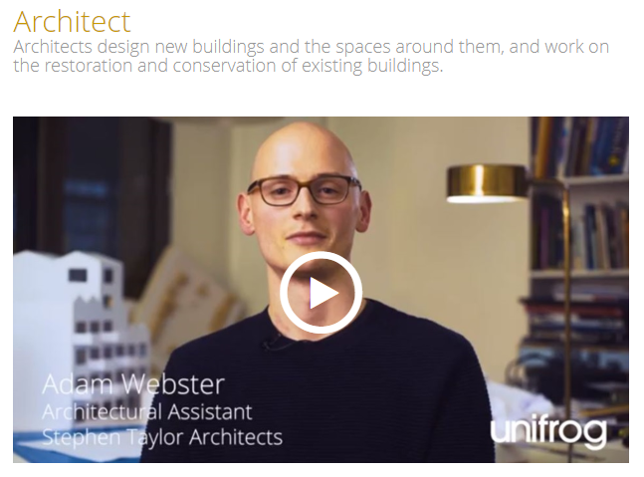
Careers Library
Over 1000 career profiles
Presents information from a range of sources
Includes qualifications and skills needed, interviews with industry professionals and labour market information
Explores progression opportunities and what a working week really looks like

Slide 32
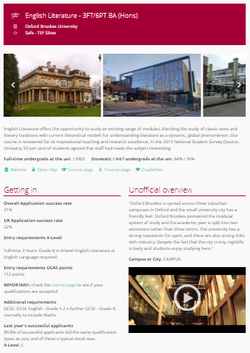
UK Universities
Students can enter subject of interest and projected grades to see all relevant university courses available in the UK
Rank and filter opportunities by factors like hours of lectures, price of accommodation and graduate job rates
Get direct links to university information pages, with impartial information on courses and institutions
Save unlimited shortlists to refer back to later

Slide 33
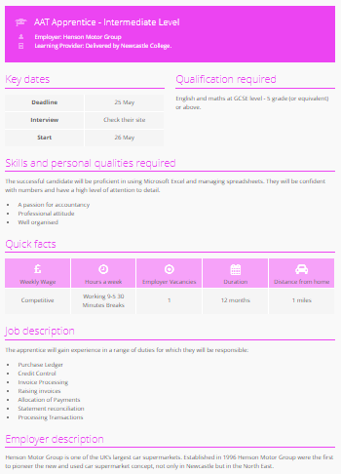
Apprenticeships
Students can find live apprenticeship vacancies
Vacancies are updated daily
Rank and filter opportunities by factors like distance from home, weekly wage and application deadlines
Direct link to the ‘apply’ page
Each apprenticeship vacancy includes practical information about the opportunity, employer and training
Save unlimited shortlists to refer back to later

Slide 34
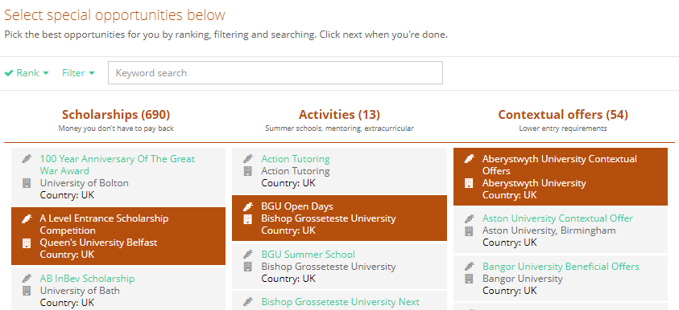
Special Opportunities
Includes £5 million-worth of grants, bursaries, scholarships, contextual offers and extracurricular activities
These can be filtered by circumstances or characteristics, depending on the access requirements of the opportunity
Includes direct links for applying
Unlimited shortlists can be created and referred back to

Slide 35
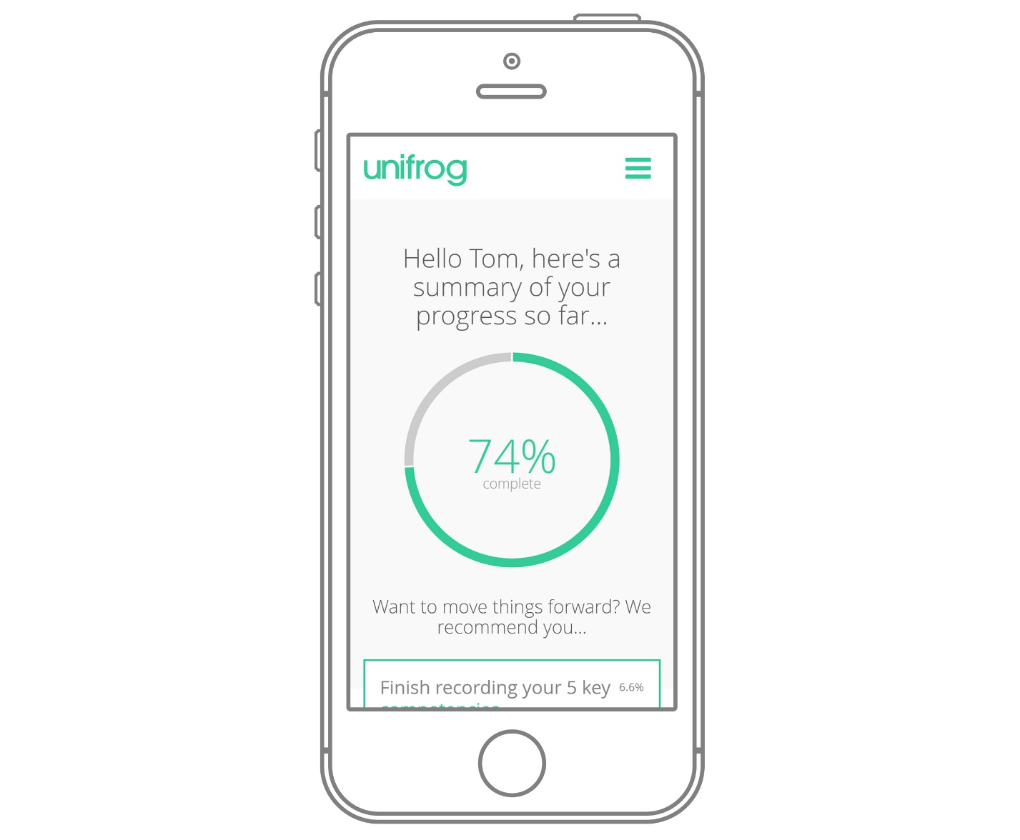
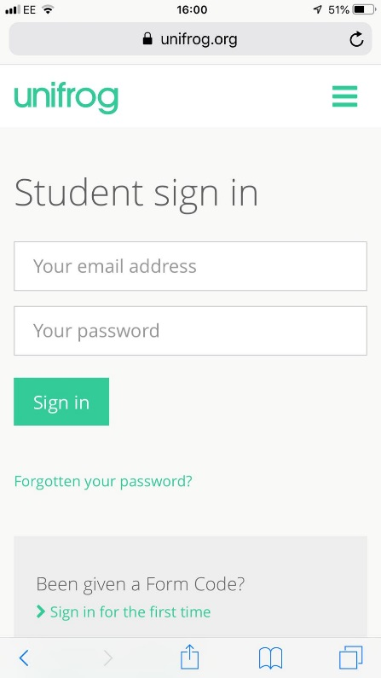
Parents & Carers, get signed up!
Go to www.unifrog.org/student and click ‘Sign in for the first time’
You’ll be asked for some details and a form code.
Please contact the Sixth Form team for the sign up code.
craydena@busheymeads.org.uk
After signing up, log into Unifrog using your email address and password via the student sign-in page!

Slide 36
Application Process
Application deadlines:
Oxford, Cambridge, Medicine and Veterinary:
  15th October 2019
All other applicants:
  15th January 2020
The Head of Sixth must ‘send’ your application so you must meet with me in good time to have it processed
Internal deadline:
  9th December 2019
‘Our School has a Mind to be Kind’
Aspire to Achieve

Slide 37

Application Process
Parents Guide
Further guidance can be found at UCAS.com
‘Our School has a Mind to be Kind’
Aspire to Achieve

Slide 38



Additional Qualifications
Some university courses require you to sit an entry exam
LNAT, BMAT, MAT and UCAT
‘Our School has a Mind to be Kind’
Aspire to Achieve

Slide 39
Students Next Steps
Before the end of the summer term, all students to register with UCAS and Unifrog
CDC’s , Mr O’Kelly and Mrs McIldowie are here to guide and support
University Open Days – student and family visits
Personal statement day
  September 2019
‘Our School has a Mind to be Kind’
Aspire to Achieve

Slide 40
Upcoming Open Days…
Thursday 20th June
Friday 21st June
London College of Fashion
University College Birmingham
University of West London
Liverpool John Moores University
Queen Mary University of London
University of Manchester
University of Bath
University of Gloucestershire
University of Reading
University of Warwick
‘Our School has a Mind to be Kind’
Aspire to Achieve

Slide 41

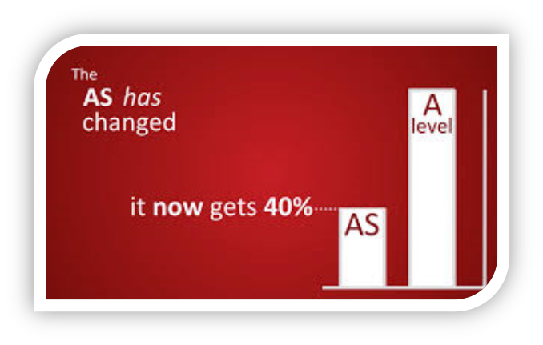
The UCAS Tariff – September 2020
UCAS has introduced a newer Tariff for the admissions cycle.
Addresses many of the shortcomings of the older model.
Significantly different method to the previous Tariff.
Note that the AS has been deliberately repositioned to 40% of an ‘A’ level.
‘Our School has a Mind to be Kind’
Aspire to Achieve

Slide 42
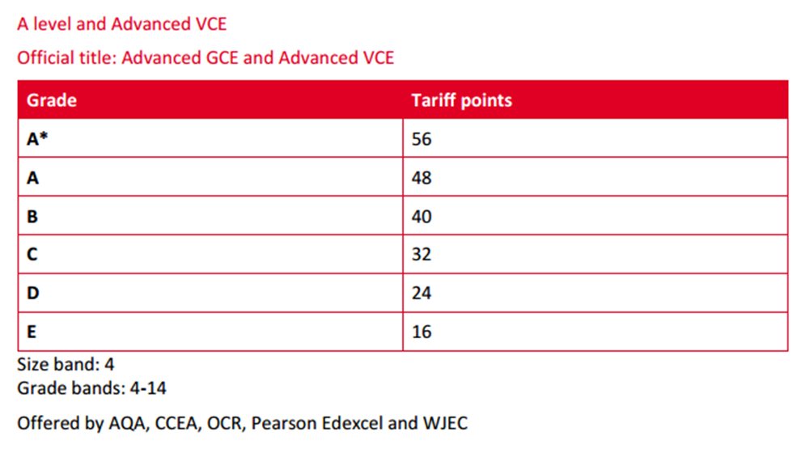
UCAS Tariff Points
This table shows the Tariff points, plus the awarding organisations that offer the qualification.
‘Our School has a Mind to be Kind’
Aspire to Achieve

Slide 43

Leon Harris
University of Hertfordshire
‘Our School has a Mind to be Kind’
Aspire to Achieve

Slide 44
The Benefits of a University Education
&
An Introduction to Student Finance
Leon Harris, Education Liaison Officer
The University of Hertfordshire

Slide 45


Why go?
… degree in a subject that interests you.
… the university experience!
… improve employment prospects.

Slide 46
Graduate Labour Market Statistics 2018
87.7% of graduates in employment
71.6% of non-graduates in employment
Graduates 3 x more likely to be in
High Skilled Jobs
Graduates earn £10,000 more than
non- graduates

Slide 47
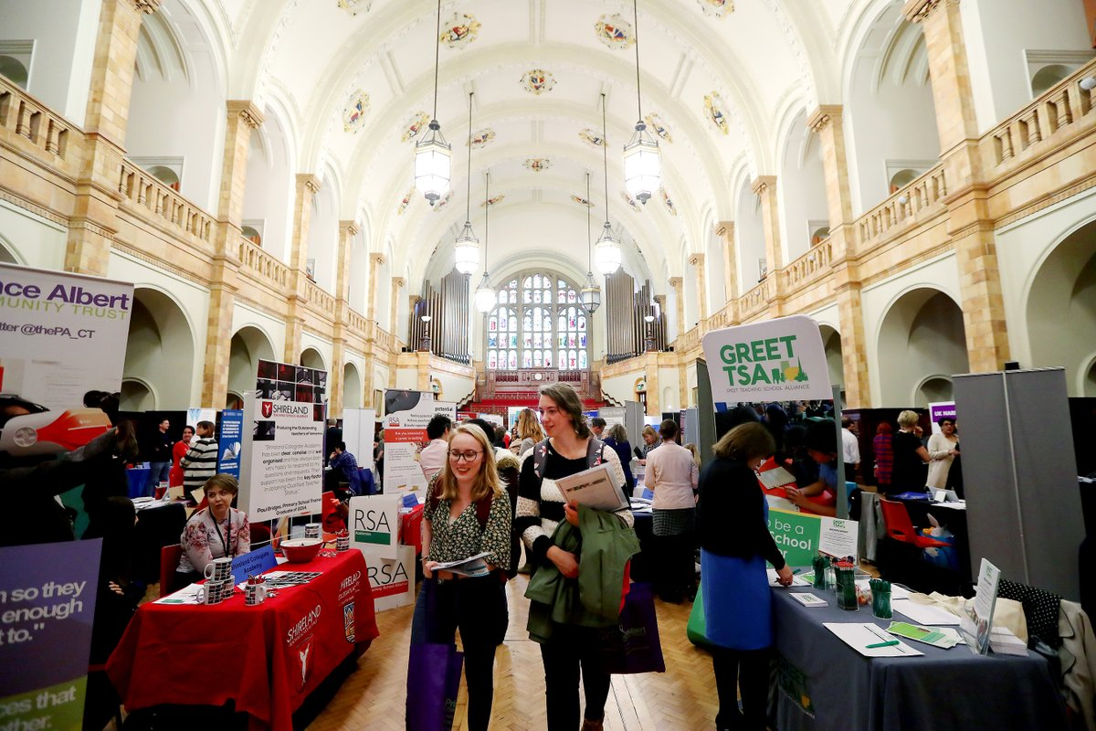
Improve employment prospects
96.5% of UH graduates in employment or further study 6 months after graduating

Slide 48
Making a Choice
www.ucas.com
Open days/Taster days
Campus V City based

Slide 49

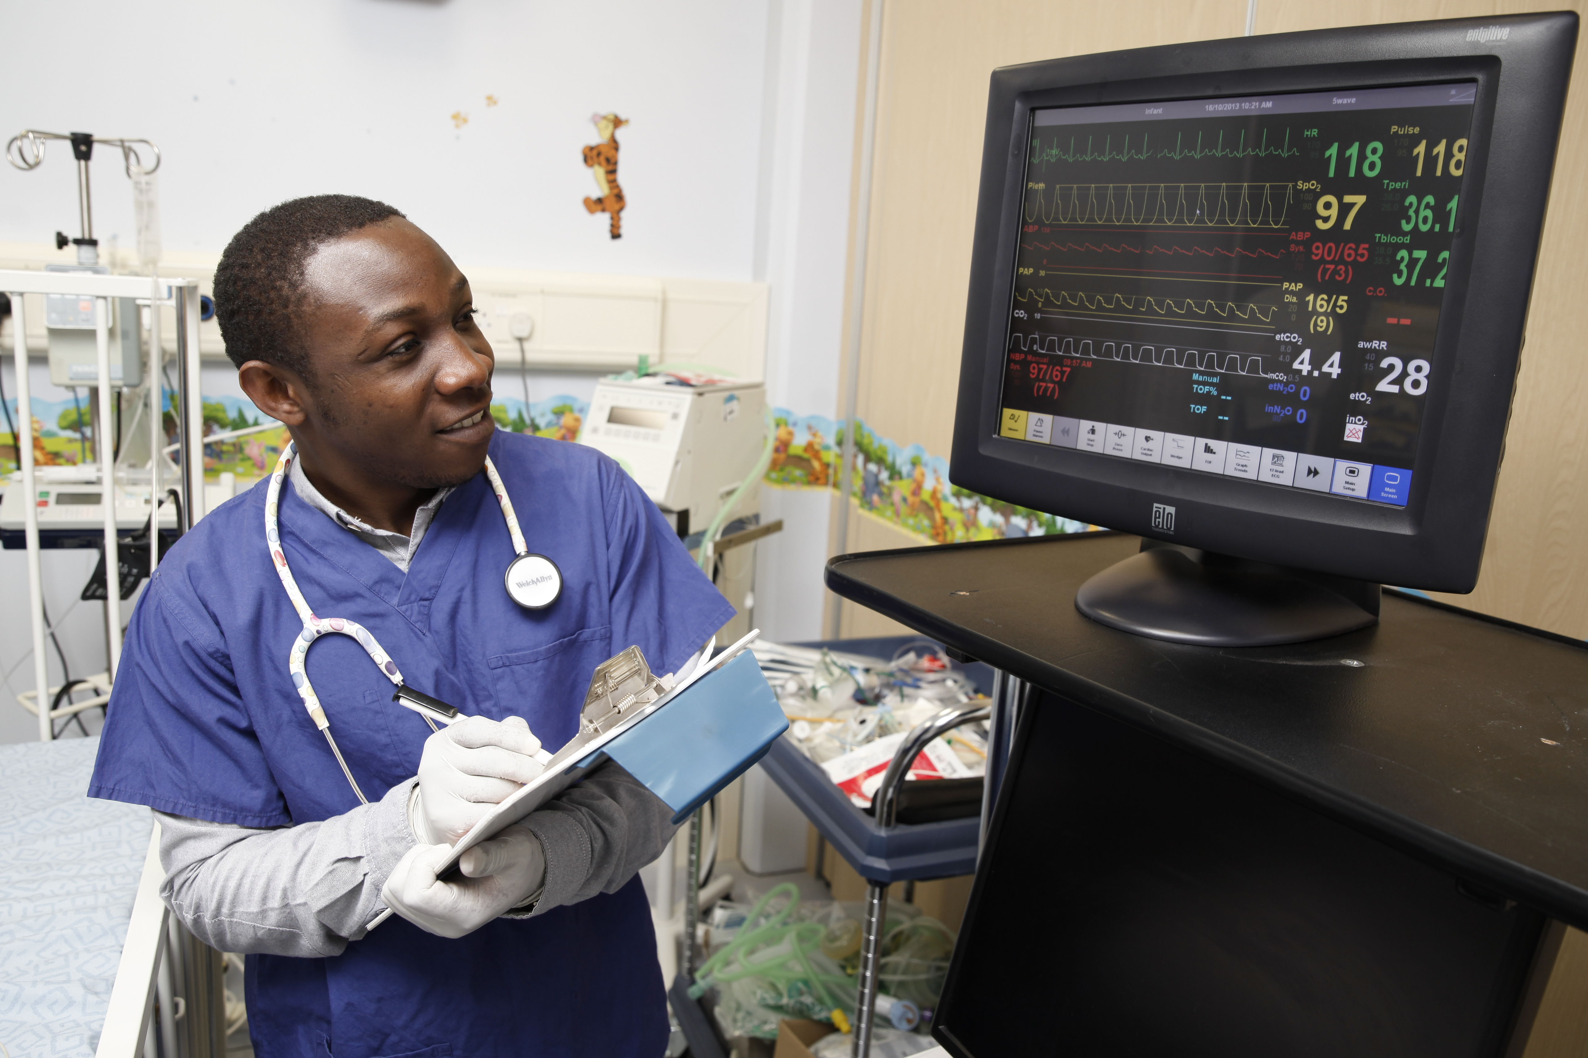


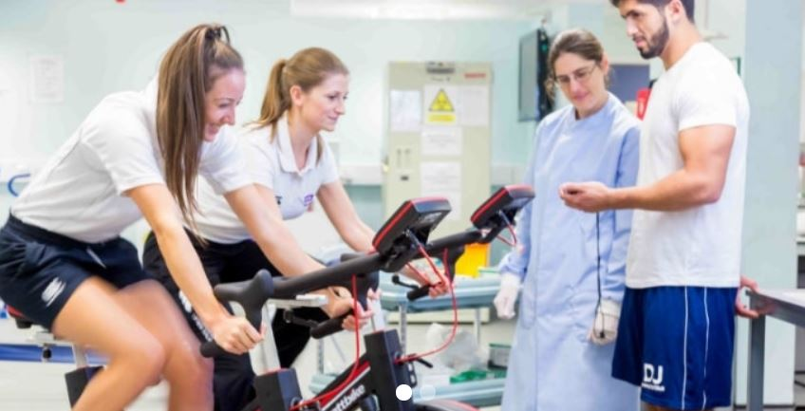


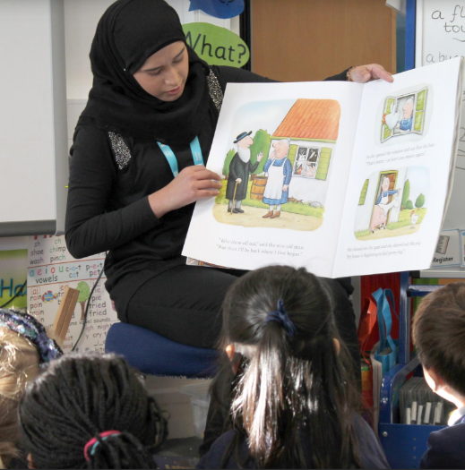
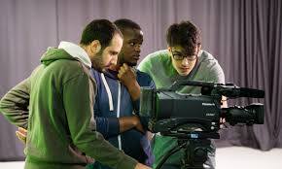
Study a specialised subject

Slide 50

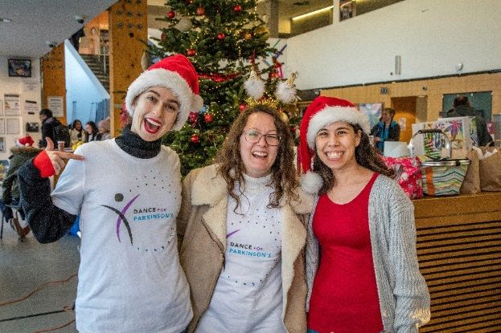

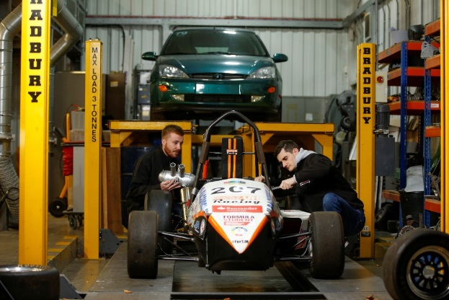
Gain Experience
& Transferable Skills

Slide 51


Study Abroad

Slide 52
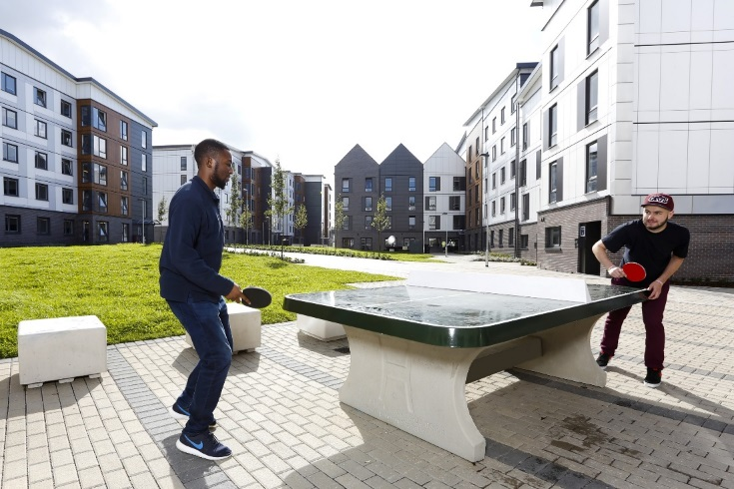



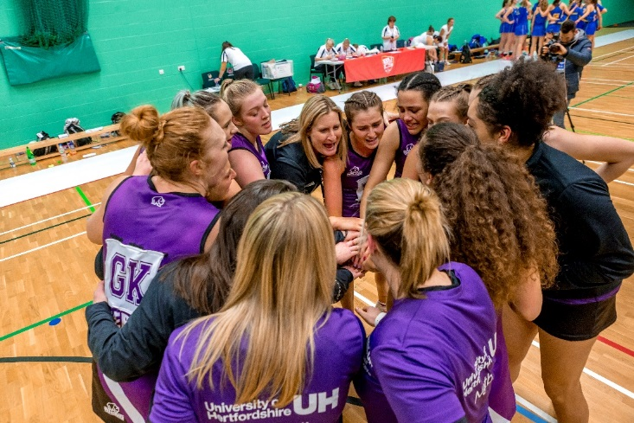
Sport & Exercise

Slide 53

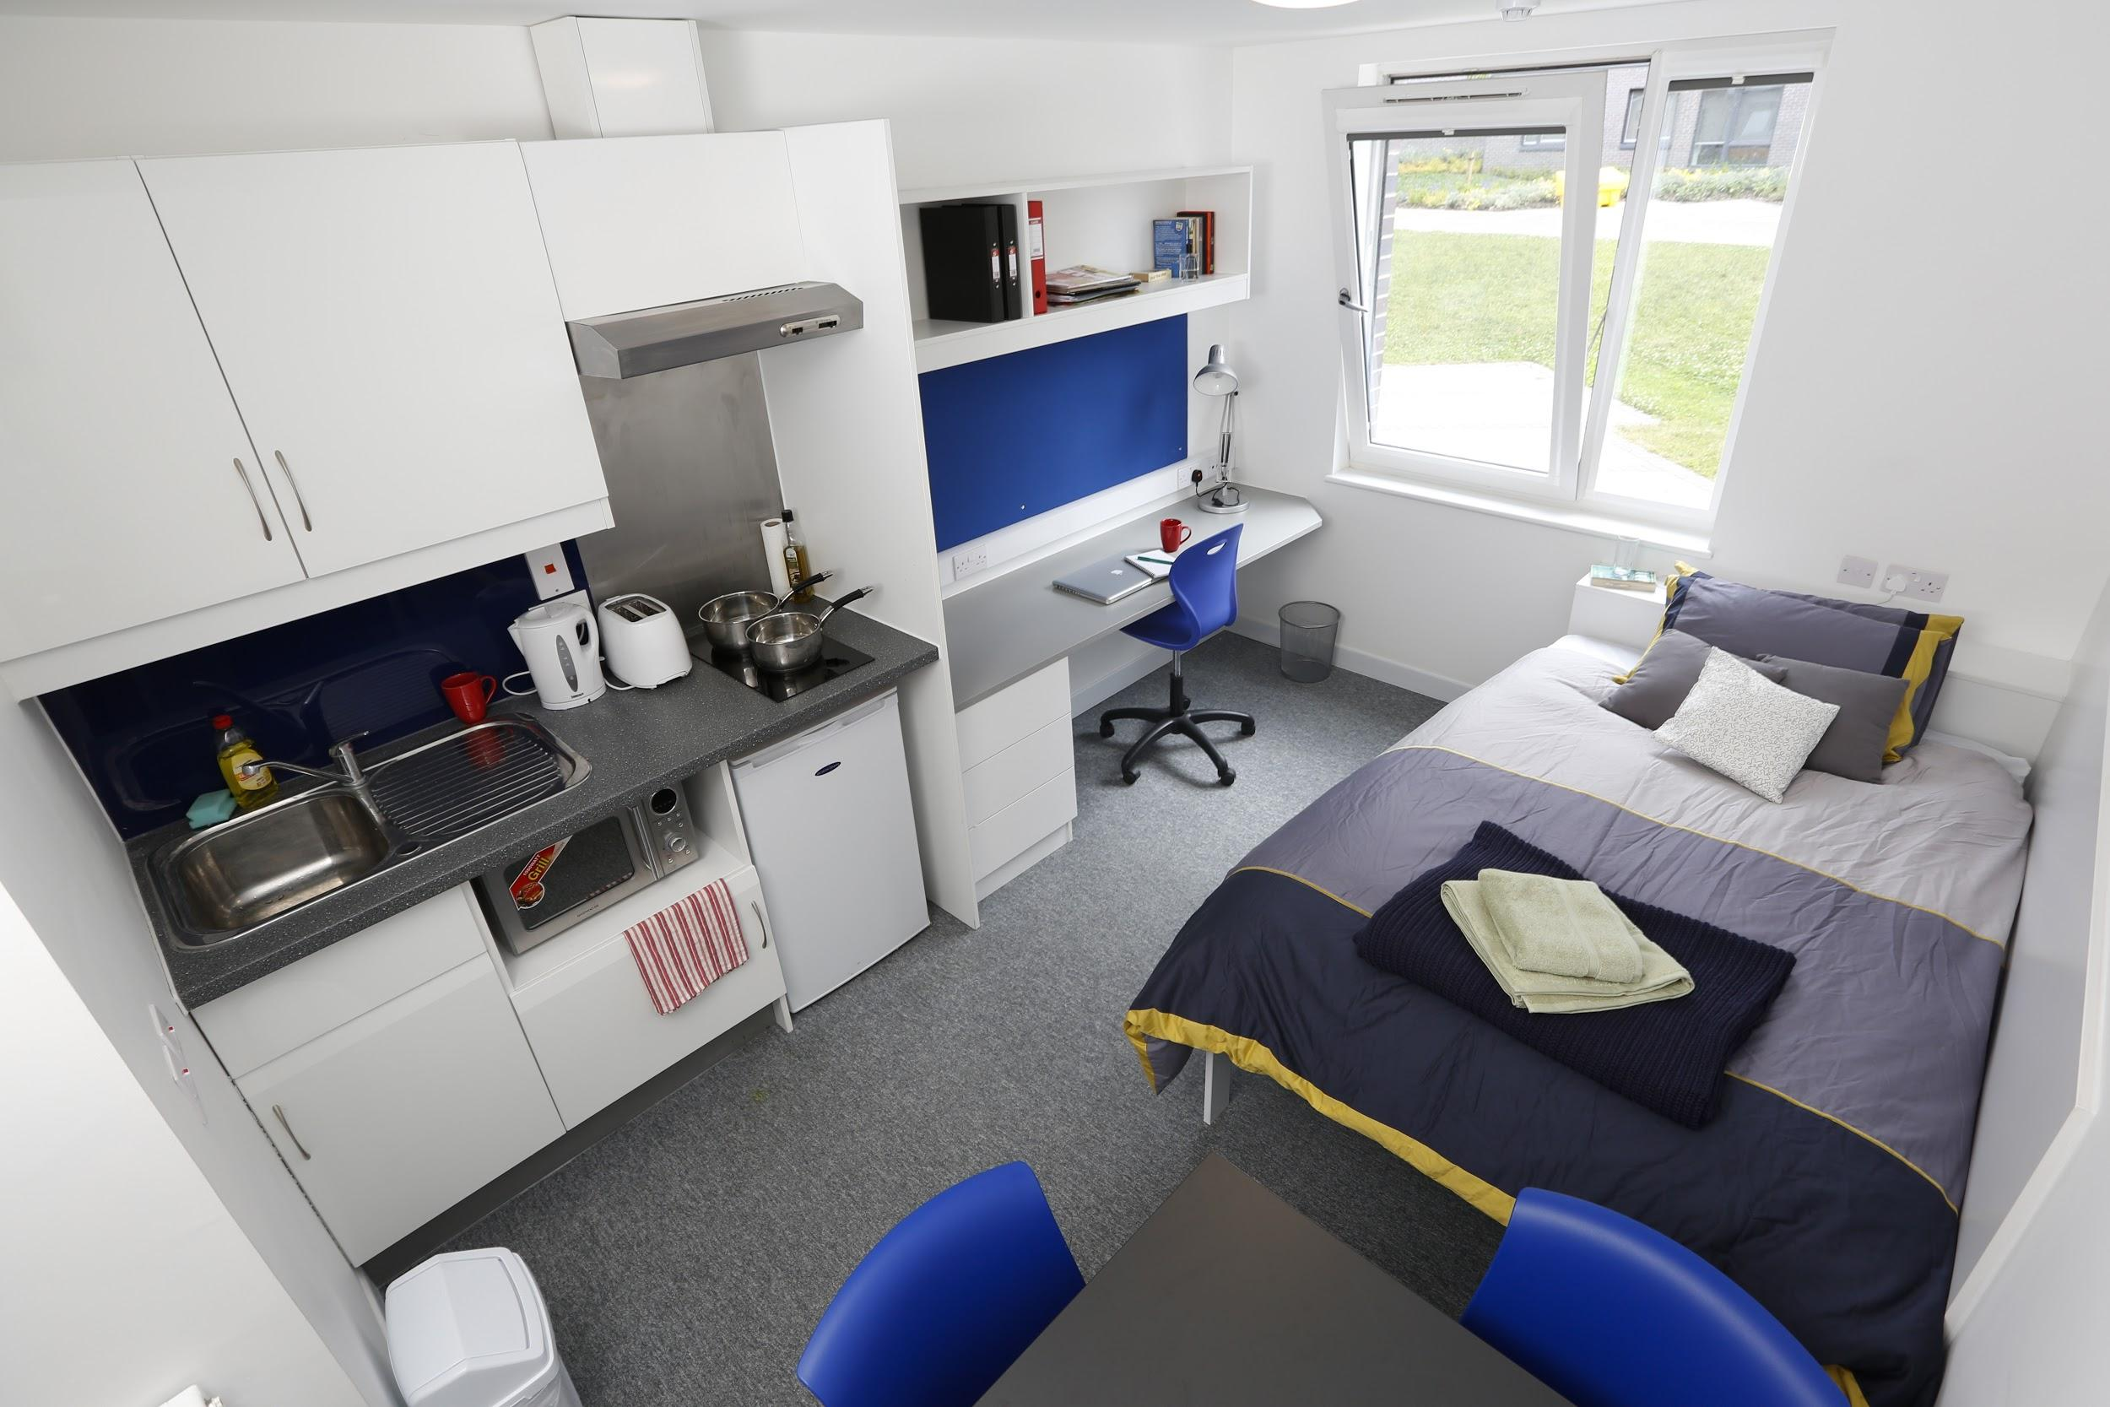
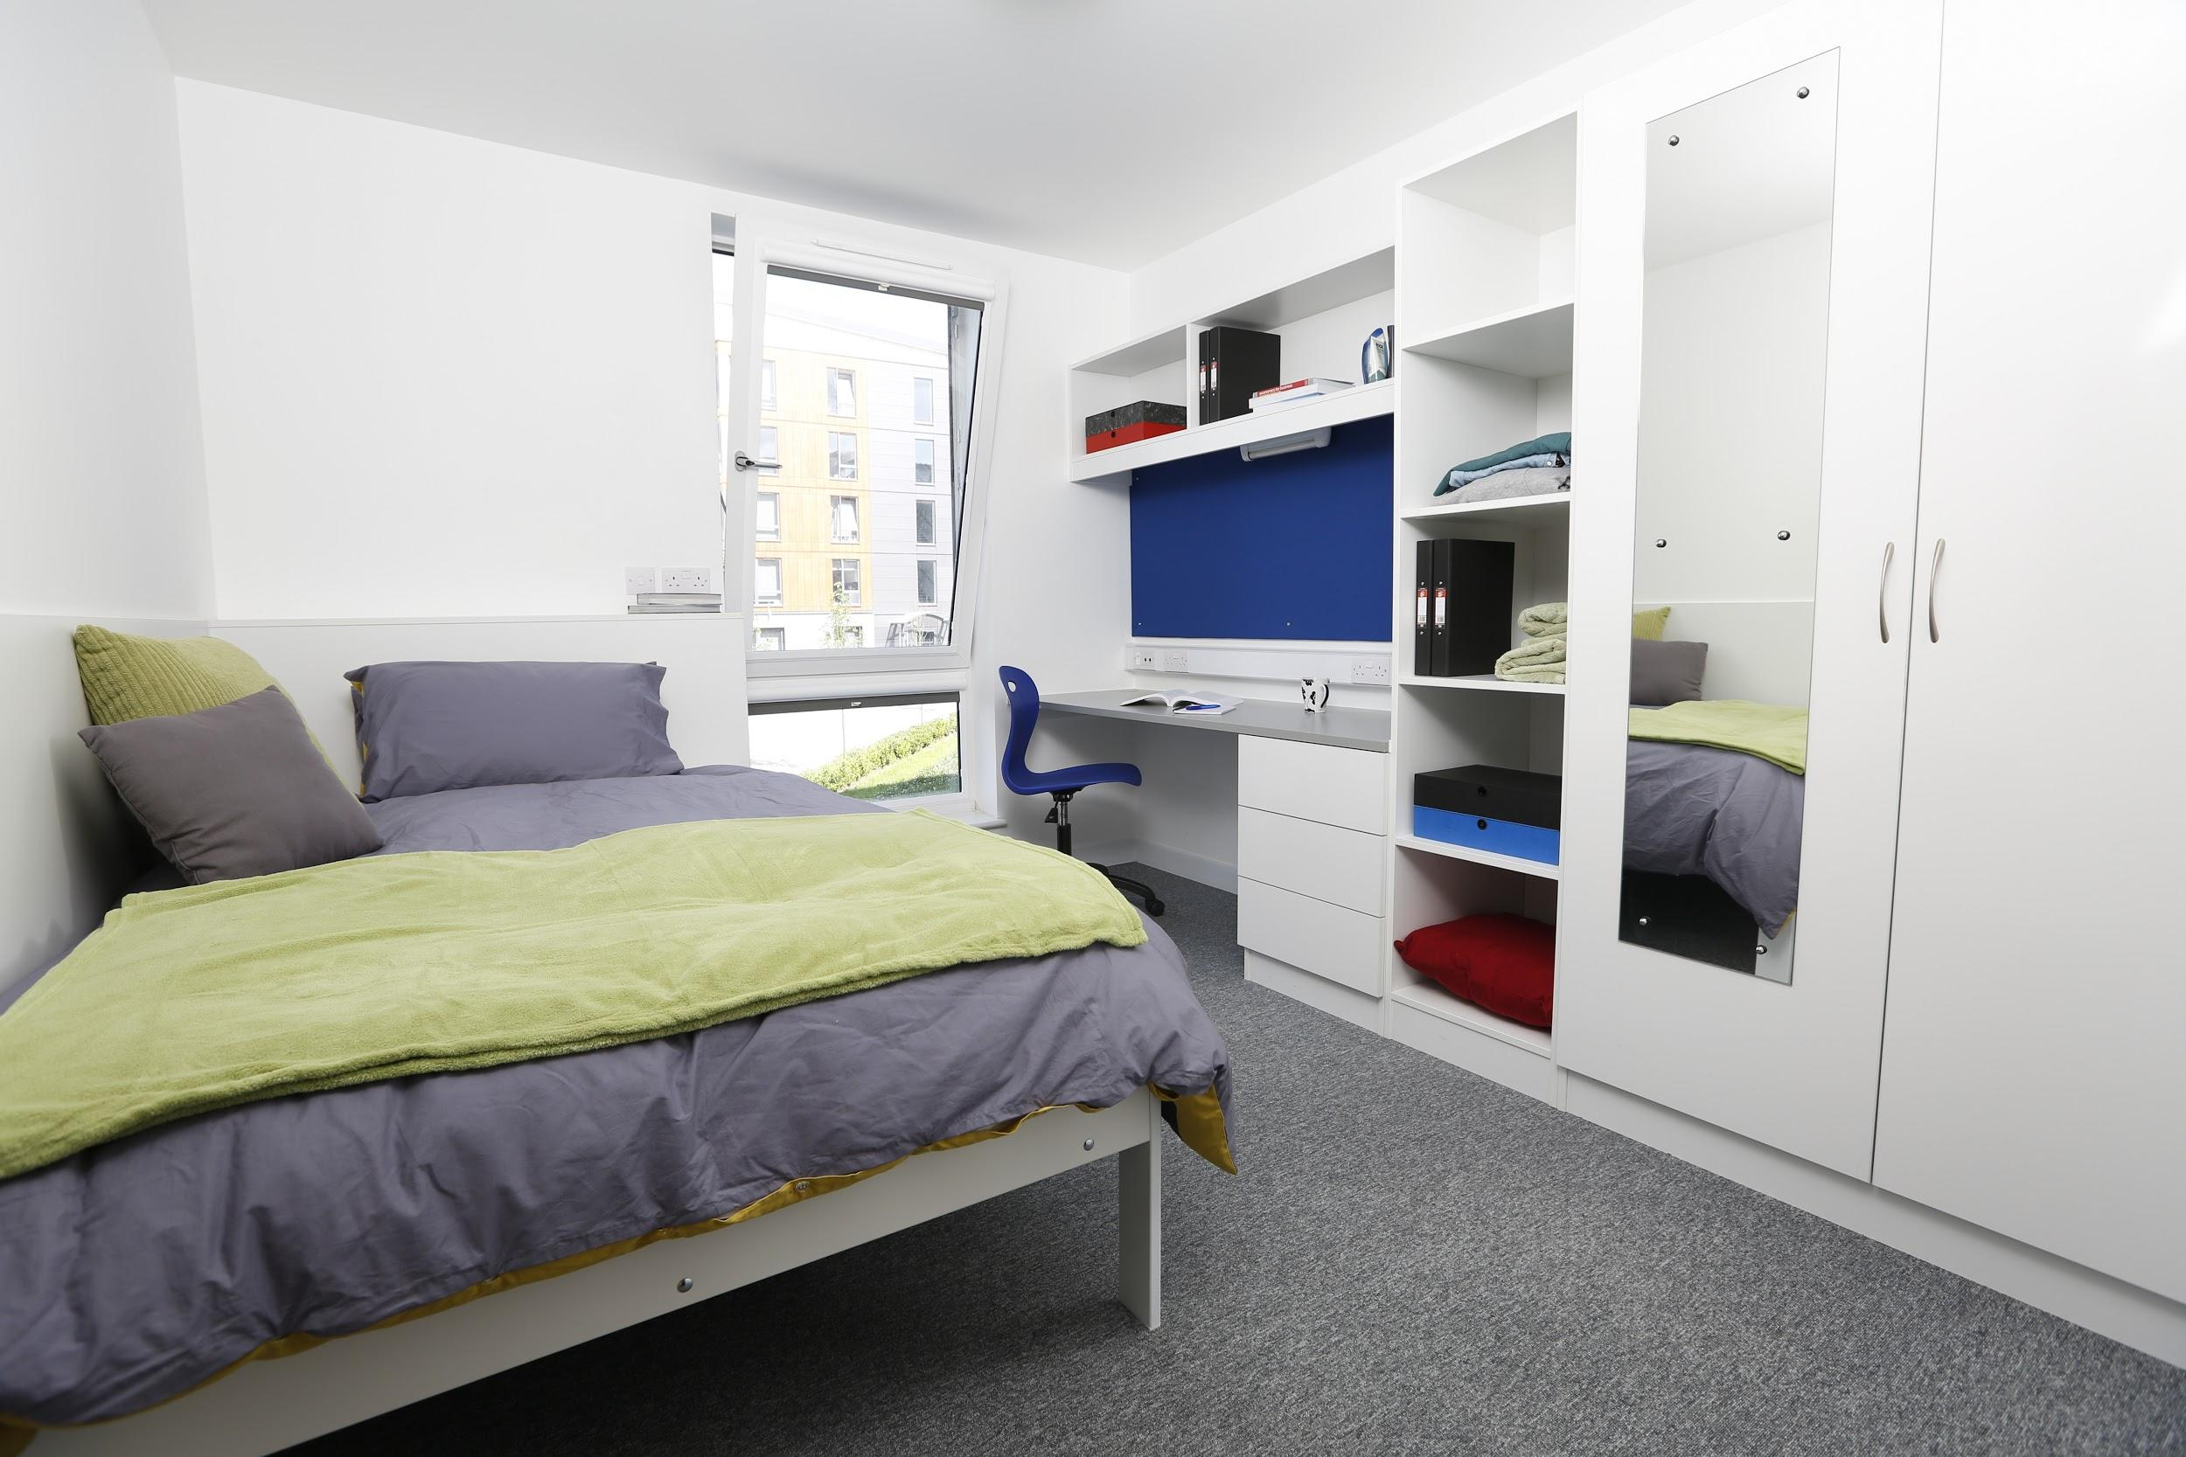
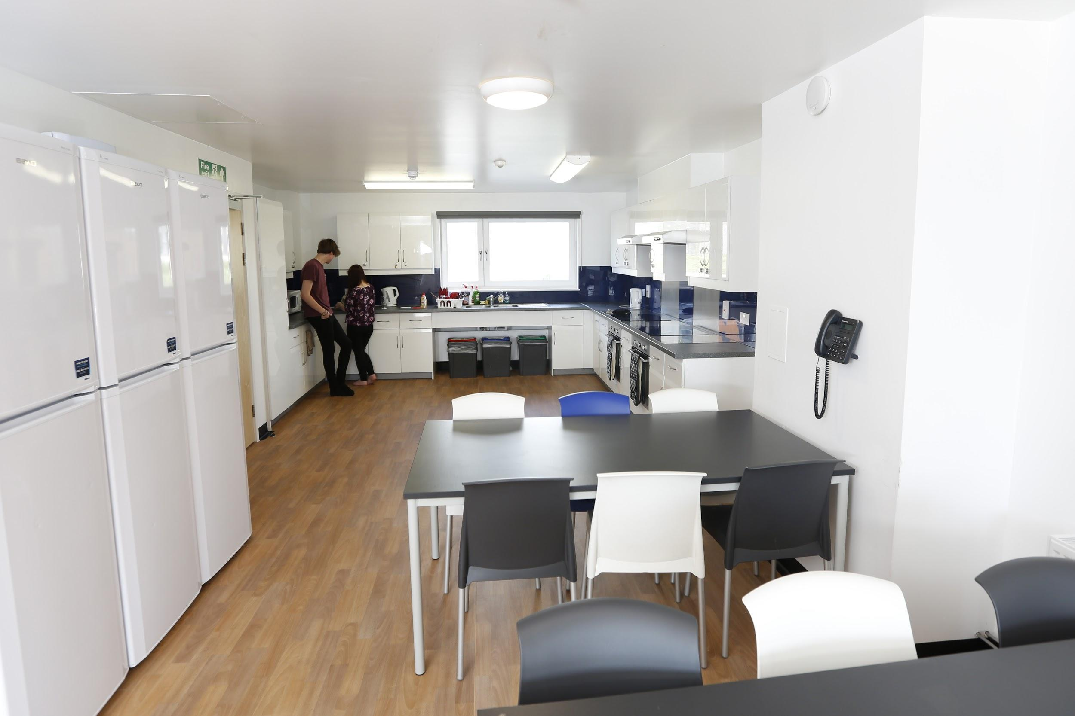

Accommodation

Slide 54
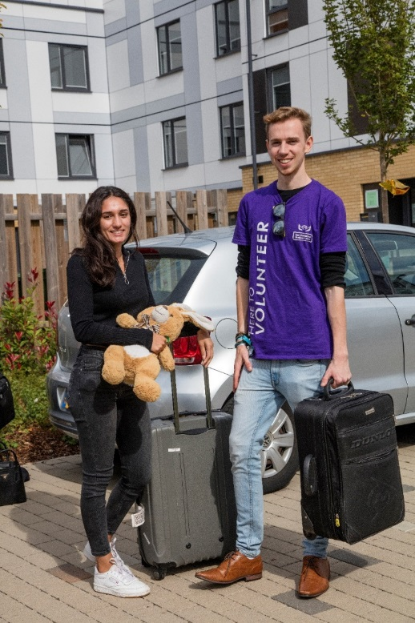
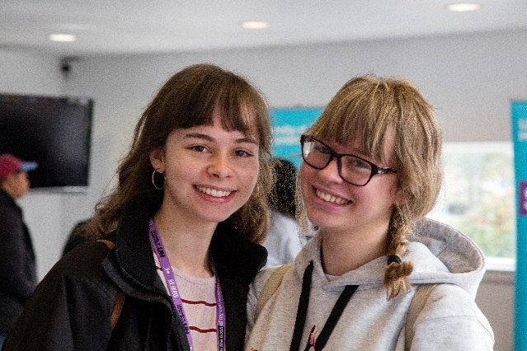
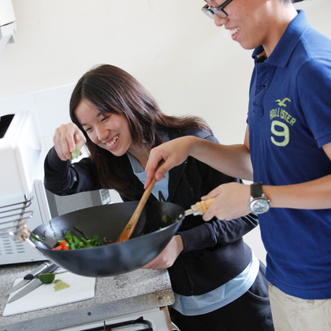


The Experience

Slide 55

Student Finance
Student Finance available to cover tuition fee and living costs whilst studying at university.
Tuition fee
Paid directly to the university for each year of study
Maintenance loan
Paid into student’s bank account
Amount received will be based on household income and where student lives whilst studying

Slide 56
Maintenance Loan
Maximum levels for 2019/20
Parental home
Live at home while you study
Up to
£7,529
0
Living away from home
Outside of London
Up to
£8,944
£
London
Live away from home & study in London
Up to
£11,672
Notes:
Click image to link to page!

Slide 57
MAINTENANCE SUPPORT
MAINTENANCE LOAN ENTITLEMENT
Household Income | Home (£58,215) | Elsewhere (62,212) | London (£69,888)
£25,000 & under | £7,529 | £8,944 | £11,672
£35,000 | £6,260 | £7,661 | £10,367
£45,000 | £4,991 | £6,377 | £9,062
£55,000 | £3,722 | £5,093 | £7,756
£60,000 | £3,314 | £4,452 | £7,103
£65,000 | £3,314 | £4,168 | £6,451
£70,000 | £3,314 | £4,168 | £5,812
i
Students can get an estimate of their student finance entitlement
using the calculator on: www.gov.uk/studentfinance
Notes:
Students on household incomes of £25,000 or less qualify for the maximum loan for living costs at the respective Home, Elsewhere or London rate of loan.
Home Rate: Students with household incomes above £25,000 lose £1 of loan for every complete £7.88 of income above £25,000 until the amount they receive reaches 44% of the maximum amount (indicated in the table above), at which point there is no further reduction. London Rate: Students with household incomes above £25,000 lose £1 of loan for every complete £7.66 of income above £25,000 until the amount they receive reaches 49.8% of the maximum amount (indicated in the table above), at which point there is no further reduction. Elsewhere Rate: Students with household incomes above £25,000 lose £1 of loan for every complete £7.79 of income above £25,000 until the amount they receive reaches 46.6% of the maximum amount (indicated in the table above), at which point there is no further reduction.

Slide 58
STUDENT FINANCE APPLICATIONS
KEY MESSAGE – APPLY EARLY
Each year thousands of students apply late for their finance and have no
way to pay for their course or accommodation, some even have to drop out
...don’t let that be you!
Apply online at gov.uk/studentfinance
Apply early to make sure your student finance is ready for the start
of your course.
You don’t need a confirmed place at university or college to apply.
Apply with your preferred choice, you can change details later if required.
Notes:
For launch and deadline dates bookmark www.thestudentroom.co.uk/studentfinance

Slide 59
Student Loan Repayments
Over £25,725
Based on what you earn
Written off after 30 years

Slide 60
Student loan repayments
You won’t make repayments until your income is over the repayment threshold.
If you study a full-time course, you will be due to start repaying in the
April after graduating or leaving your course.
You’ll repay 9% of your income over the threshold.
If your income falls below the threshold, your repayments will stop.
Any outstanding loan balance will be cancelled 30 years after entering repayment.
Notes:
The current UK threshold is:
£480 a week
£2,083 a month
£25,000 a year

Slide 61

Student loan repayments
Income each year before tax | Monthly salary | Monthly repayment (Approx)
£25,725 | £2,083 | £0
£27,000 | £2,250 | £9
£30,500 | £2,500 | £28
£33,000 | £2,750 | £54
£35,000 | £2,916 | £69
You pay 9% of your income over the threshold
Monthly
repayment?
Interest is applied to your loan. More info can be
found on www.slc.co.uk/repayment
Notes:
Interest is charged from the day the first payment is made to the uni or college until the loan is repaid in full or cancelled. The interest rate is based on the UK Retail Price Index (RPI) and will vary depending on the student’s circumstances.
The Retail Price Index (RPI) is a measure of UK inflation. It measures changes to the cost of living in the UK.
The interest rate is updated once a year in September, using the rate of RPI from March.
While studying until entering repayment = RPI +3%
On entering repayment interest is linked to earnings on a sliding scale up to a maximum of RPI + 3%

Slide 62





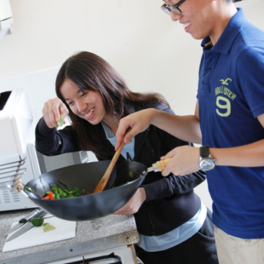


Accommodation
Bills
Social life
Travel
Laundry
Food & drink
Clothes
Books

Slide 63


Extra Support
Bursaries
Scholarships
Hardship fund (financial-support@herts.ac.uk)
Disabled Students’ Allowances (DSAs)
www.gov.uk/disabled-students-allowances-dsas
Check university/college websites and ask at open days to see
what they offer and how/when to apply....don’t miss out!!

Slide 64

A well respected qualification Gain transferable skills
Increase employment prospects Make friends and connections for life

Slide 65
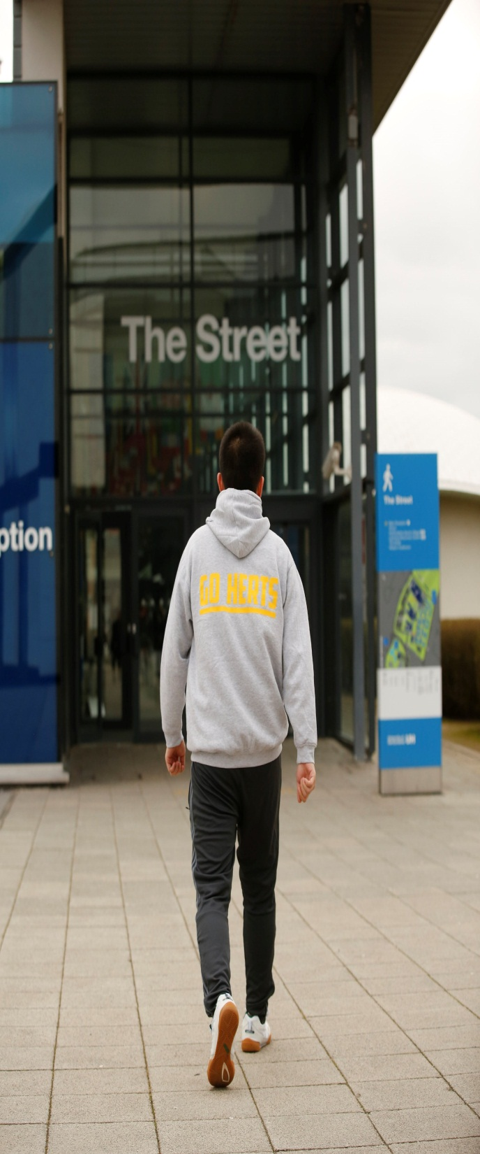
Come and visit us!
Wednesday 10th July – University Application Process
Information Evening
Saturday 12th October- Open Day

Slide 66
Bushey Meads Sixth Form
Next Steps Evening
‘Our School has a Mind to be Kind’
Aspire to Achieve

